Slide 1
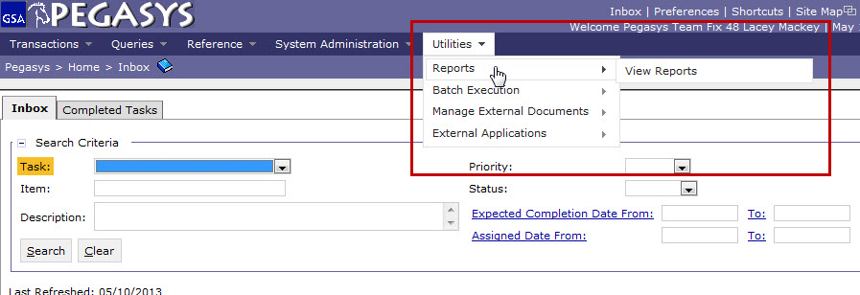
Generating Monthly Credit Card Transaction Report
Click Utilities > Reports > View Reports

Slide 2
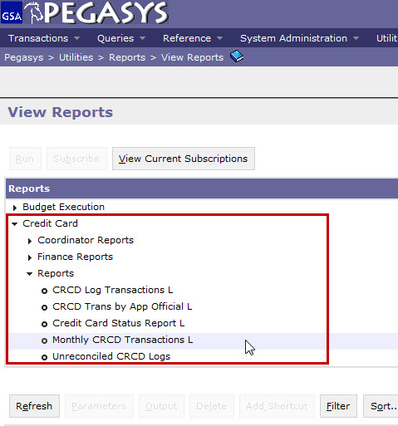
Generating Monthly Credit Card Transaction Report
Click
Credit Card > Reports > Monthly CRCD Transactions L
Click Run

Slide 3
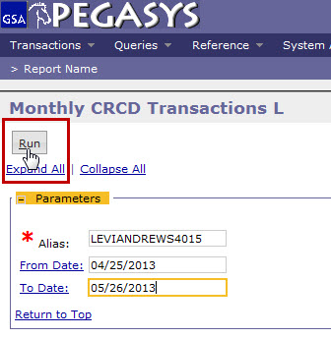
Generating Monthly Credit Card Transaction Report
Enter Credit Card Alias
Enter From Date and To Date
Click Run

Slide 4
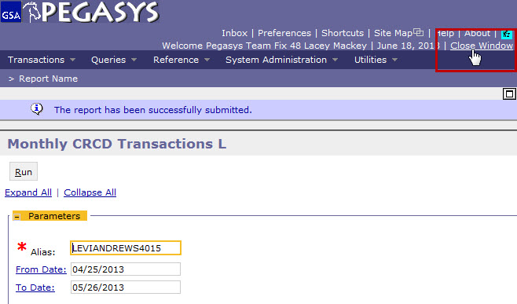
Generating Monthly Credit Card Transaction Report
Note if the information message stating, “The report has been successfully submitted.” is at the top of the screen
Close the window

Slide 5
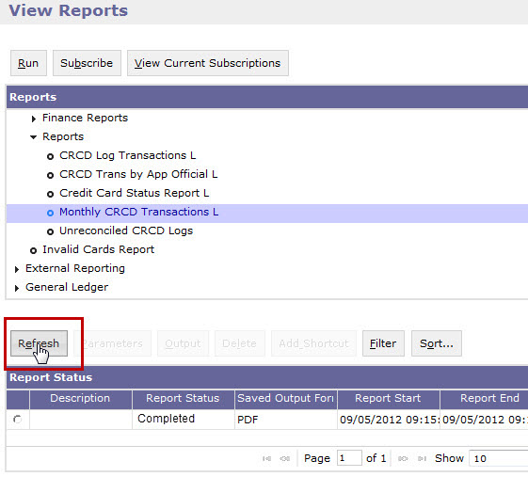
Generating Monthly Credit Card Transaction Report
View original screen
Click Refresh

Slide 6
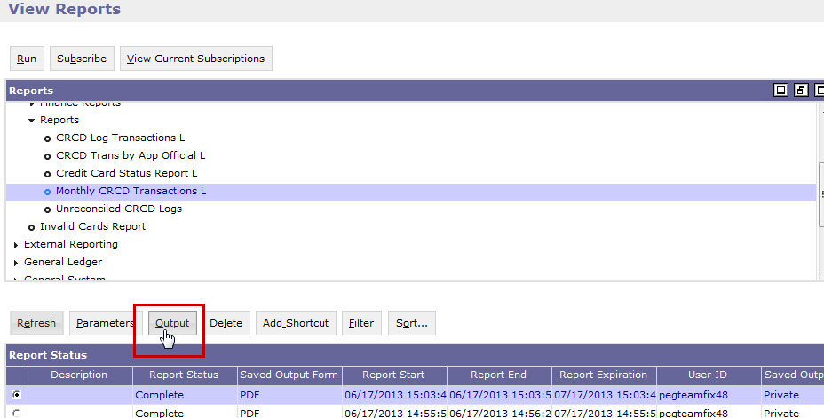
Generating Monthly Credit Card Transaction Report
Click radio button to left of report
Click Output
Note: If your report is pending, wait a few minutes and click refresh again.

Slide 7
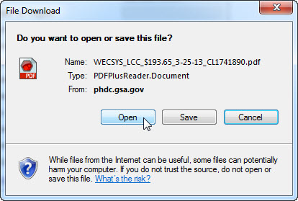
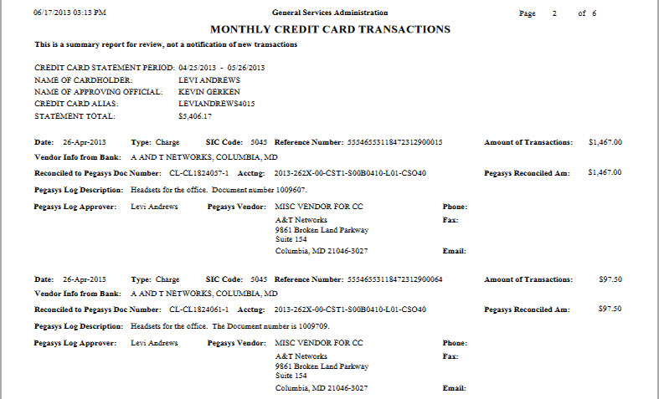
Generating Monthly Credit Card Transaction Report
Click Open when File Download box appears

