Slide 1
GSA’s Vendor and Customer
Self Service (VCSS)
Notes:
Hello and welcome to GSA’s Vendor and Customer Self Service (VCSS) training course. This course has been developed to walk you through the navigation and functionality of VCSS. You are listening to Segment 1, Introduction

Slide 2
VCSS Presentation
GSA’s Vendor and Customer Self Service (VCSS) presentation material is organized into eight smaller segments in order to facilitate training and future reference.
  The Table of Contents on the next slide, lists all segments of the VCSS presentation. The segment highlighted is the segment of the presentation that is covered.
  All segments of the VCSS presentation can be accessed on the GSA VCSS Launch Page: http://vcss.gsa.gov.
Notes:
This course is organized into 8 smaller segments for your convenience, so that you can view just the segments that you need. All segments can be found online through GSA’s VCSS Launch Page

Slide 3
Table of Contents
Segment 1: Introduction (Slides A1 - A5)
  Background
  Quick Reference for Important Facts
  Vendor and Customer Self Service Overview
  GSA Launch Page Overview
Segment 2: VCSS Account Registration & Requesting Access (Slides B1 – B37)
Segment 3: Basic Navigation (Slides C1 - C35)
Segment 4: Account Information (Slides D1 - D32)
Segment 5: Statement and Dispute Information (Slides E1 - E39)
Segment 6: Customer Payment Information (Slides F1 - F23)
Segment 7: Correspondence Information (Slides G1 - G19)
Segment 8: External Applications Information (Slides H1 - H6)
Notes:
In Segment 1 we will cover background of the new software, important facts for quick reference, an overview of VCSS, and an overview of the GSA launch page

Slide 4
Background
Billing and Accounts Receivable (BAAR) is a major Commercial Off The Shelf (COTS) implementation initiative to modernize General Services Administration (GSA) billing, accounts receivable, and collection systems (BAAR).
  This includes new web functionality available through Vendor and Customer Self Service (VCSS).
BAAR will be implemented using a phased approach:
  Phase 1: Rent* & Fleet
  Phase 2: RWA, HOTD, Global Supply, Automotive Purchases, TMSS, SIFT, Real Property Disposal, Miscellaneous Manual Business Lines
  Phase 3: AAS, Expanded Services, Wide Area Network (WAN), Local Service, Telework, Claims, Outleases, Miscellaneous Manual Business Lines
BAAR will introduce new terminology.
  For example: BOAC becomes Account Code.
For additional information please visit the BAAR website: www.gsa.gov/baar.
*Federal Agency Rent bills are still be available from Rent On the Web (ROW)
A1
Notes:
GSA is implementing new software to help modernize it’s billing, accounts receivable and collection systems. This new billing and accounts receivable software is known as BAAR, and will also include new web functionality through the Vendor and Customer Self Service portal.
BAAR will be implemented in three phases, based on functionality required by GSA business lines. Phase 1 will include RENT and FLEET. Phase 2 and Phase 3.
There will also be new terminology introduced. For example, BOAC codes will now be called Account codes.

Slide 5
Vendor and Customer Self Service Overview
Vendor and Customer Self Service (VCSS) is a web application that allows users to quickly and efficiently access information concerning their accounts.
  VCSS provides a single location for GSA customers to do the following:
    View account information (e.g. outstanding balances, business line totals, statement information).
    Submit correspondence – correspondence is a message between a customer and GSA regarding your account or a specific payment, refund or statement.
    Submit a dispute request for a statement that you think might be in error.
  There are two types of registration:
    When an account is registered in VCSS, it is referred to as a “VCSS account”. An account is identified using the account code provided when your outlease was initiated.
    Your individual user login to access VCSS is referred to as a “User ID”. Users may have access to one or more VCSS accounts.
A2
Notes:
Here is an overview of the Vendor and Customer Self Service web application.
VCSS is a website, created for your convenience to access your account information quickly and efficiently online.
You can send correspondence with GSA for communication purposes. You can also submit a dispute for a statement.
There are two levels of registration in VCSS.
When a customer is first registered in VCSS, a VCSS account is created. Accounts are identified by an account code, which you may know as a BOAC or Agency Bureau code. You will also be given a User ID to log into VCSS. It’s important to note that some users may have access to one or more VCSS accounts.

Slide 6

GSA Launch Page Overview
The GSA Launch Page is a GSA website that provides GSA customers a single location to do the following:
  Launch the VCSS website.
  Request a VCSS account registration.
  Request access to an existing VCSS account.
  Access GSA’s VCSS instructions and documentation.
Access the GSA launch page by entering the following URL (web address) in your web browser:
    http://vcss.gsa.gov
A3
Notes:
The GSA launch page provides ability to the following.
Launch the vcss website, register a vcss account, request access to a vcss account, and access vcss instructions and documentation. You can get to this launch page by entering the following url in your web browser.

Slide 7
Quick Reference for Important Facts
Register a VCSS account (Segment 2)
Request access to a VCSS account (Segment 2)
Login to VCSS (Segment 3)
Set up security questions to retrieve password (Segment 3)
Access help (Segment 3)
Learn the search limit (Segment 3) and (Segment 5)
View a summary of your account (Segment 4)
View and print statements (Segment 5)
Dispute a statement (Segment 5)
View a payment (Segment 6)
View a refund (Segment 6)
View account or statement correspondence (Segment 7)
Create account or statement correspondence (Segment 7)
Access an external application (Segment 8)
A4
Notes:
Here is a short list of tasks covered in each segment that you can use for your reference.

Slide 8
References
    Return to the GSA VCSS Launch Page to access other segments of the VCSS presentation: http://vcss.gsa.gov.
  Segment 1: Introduction
  Segment 2: VCSS Account Registration & Requesting Access
  Segment 3: Basic Navigation
  Segment 4: Account Information
  Segment 5: Statement and Dispute Information
  Segment 6: Customer Payment Information
  Segment 7: Correspondence Information
  Segment 8: External Applications Information
A5
Notes:
This concludes segment 1 of the VCSS presentation. Now that you have introduction to VCSS, feel free to listen to Segment number 2 to learn about registering a VCSS account and requesting access. These segments can found at the GSA VCSS launch page.
Thanks

Slide 9
Table of Contents
Segment 1: Introduction (Slides A1 - A5)
Segment 2: VCSS Account Registration & Requesting Access (Slides B1 - B37)
  Registration Overview
  Register New Account
  Request Access to Existing Account
Segment 3: Basic Navigation (Slides C1 - C35)
Segment 4: Account Information (Slides D1 – D32)
Segment 5: Statement and Dispute Information (Slides E1 - E39)
Segment 6: Customer Payment Information (Slides F1 - F23)
Segment 7: Correspondence Information (Slides G1 - G19)
Segment 8: External Applications Information (Slides H1 - H6)
Notes:
In Segment 2 we will cover an overview of the registration process, how to register a new account, and how to request access to an existing account

Slide 10
VCSS Registration Overview
VCSS Account Registration is the process you complete in order to register a VCSS account
  The first person that registers the account in VCSS must agree to become the account administrator.
  As an account administrator, your responsibilities include approving or disapproving all new user access to the VCSS account.
  You can only register one VCSS account at a time.
A User ID must also be created in order to access VCSS
  During the approval process for a new VCSS Account registration you can create a new User ID
  You can ask GSA to create a User ID to access existing VCSS Accounts
B1
Notes:
The process we are about to cover is geared towards those that are going to register a VCSS account.

Slide 11
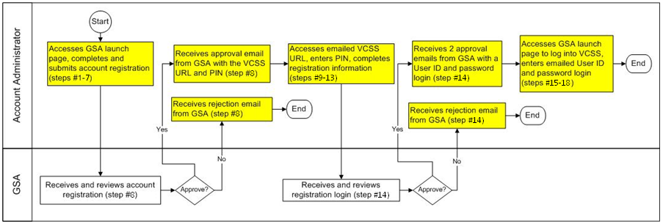
VCSS Registration Process
This is the high level process diagram illustrating the steps to register a VCSS account.
B2
Notes:
Here is the high level process of the steps taken to register for a VCSS account. We are going to review the details for each step in this diagram in the next few slides.
This is a process diagram for the VCSS registration process, which is organized with boxes and rows. Each box represents a step in the registration process. Each row is called a “swim lane” that lists the person responsible for each step.
First, the account administrator accesses the GSA launch page to complete and submit the account registration, which is covered in steps number 1 through 7.
Next, GSA receives and reviews the account registration for approval, which is covered in step number 8.
If GSA approves the account registration, then the account administrator receives an approval email from GSA with the VCSS URL and Personal Identification Number.
However, if GSA does not approve the account registration, then the account administrator receives a rejection email from GSA. Since the account registration has been rejected, the process ends here.
In the case that the account administrator receives an approval email from GSA, then they access the emailed VCSS URL, enter their PIN, and complete the registration information to request a login, which is covered in steps number 9 through 13.
Next, GSA receives and reviews the registration login for approval, which is covered in step number 14.
If GSA approves the login registration, then the account administrator receives two approval emails from GSA. One email contains your new User ID login. The second email contains your password.
However, if GSA does not approve the registration login, then the account administrator receives a rejection email from GSA. Since the login registration has been rejected, the process ends here.
In the case that the account administrator receives the two approval emails from GSA, then they access the GSA launch page to login to VCSS, and then enter their User ID and password in the emails from GSA, which is covered in steps number 13 through 18.

Slide 12
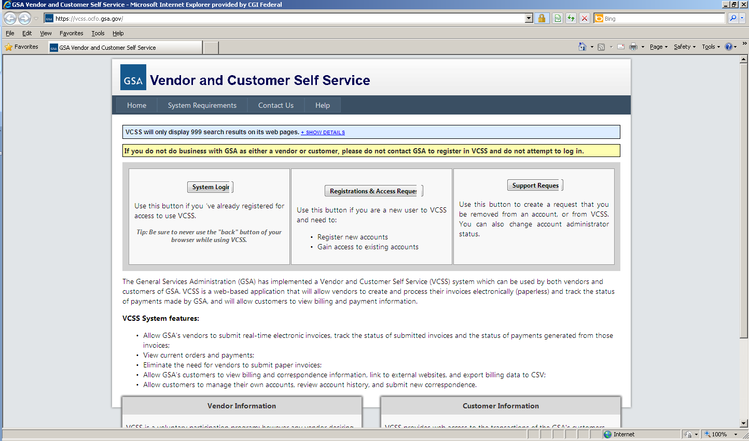
VCSS Registration Steps
  To register a VCSS account, perform the following steps covered in the next few slides.
  Go to the GSA Launch page (http://vcss.gsa.gov) and select the Registrations and Access Request button to register a VCSS account.
B3
Notes:
We are now going to review the detailed steps of the VCSS account registration process.
First, access the GSA Launch page URL, which is http://vcss.gsa.gov.

Slide 13
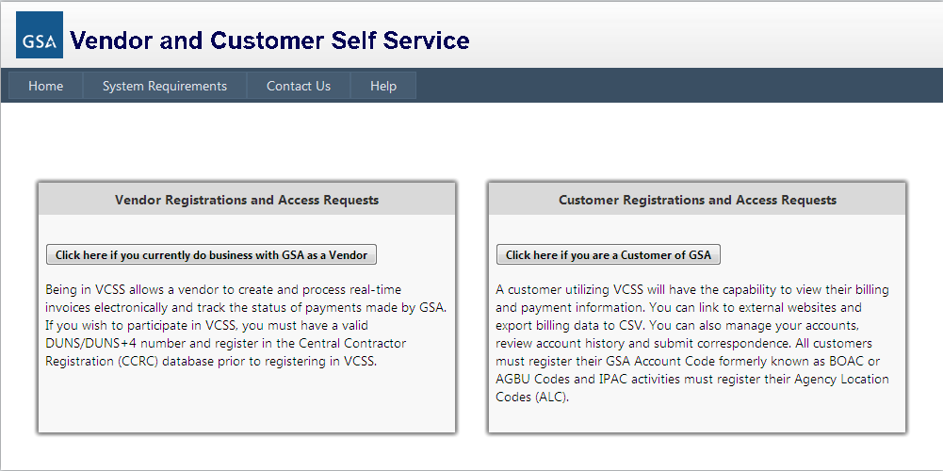
VCSS Registration Steps (Cont’d)
  On the GSA launch page, select the Click here if you are a Customer of GSA button to register for a customer account.
Non- Federal customers do not have BOAC’s or AGBU. Users should register their Account codes given to them by there GSA representative.
B4

Slide 14
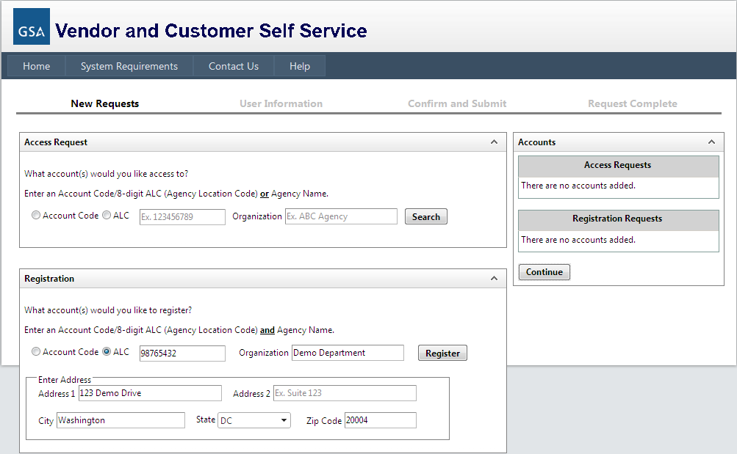
VCSS Registration Steps (Cont’d)
  On the next screen of the GSA launch page, in the Registration section, identify the customer you are registering by entering:
    Account Code, provided to you specifically for VCSS registration when your outlease was initiated
    Organization Name, which is the name of the customer organization you are registering.
    Address Information, which is the address of the customer organization you are registering.
B5

Slide 15
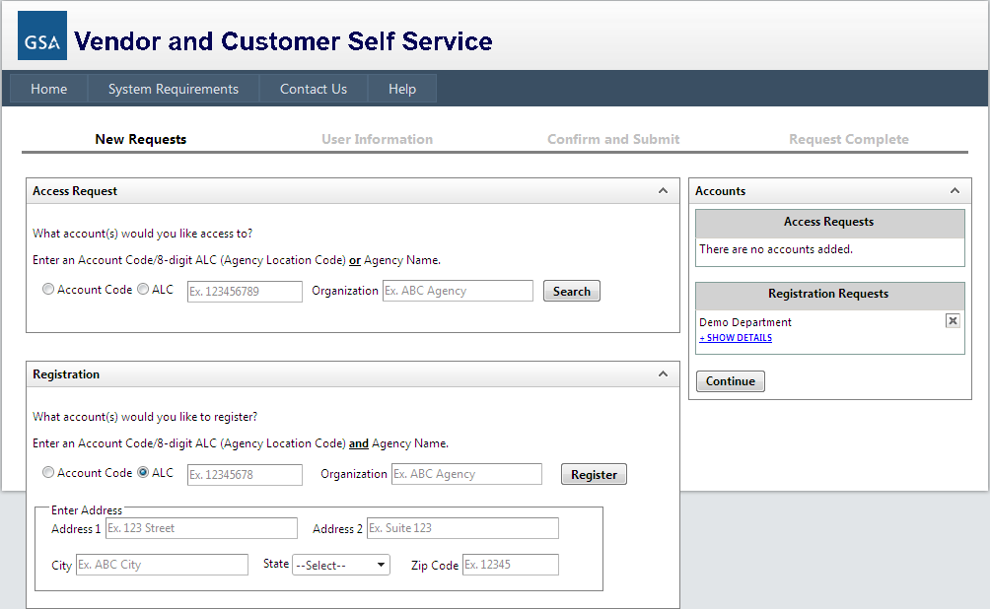
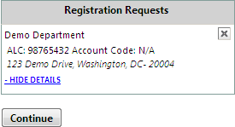
VCSS Registration Steps (Cont’d)
  Select the Register button to continue the registration.
    The Registration Requests section is populated with the Organization Name you provided in the Registration section.
    Select +Show Details to view the details you entered for the registration.
    Select the X to remove the registration and start over.
    Select the Continue button to continue the registration.
B6

Slide 16
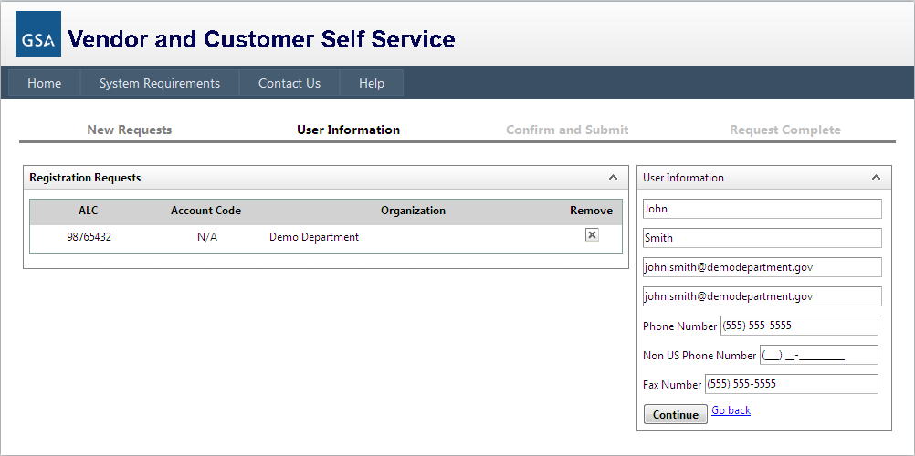
VCSS Registration Steps (Cont’d)
  On the next screen of the GSA launch page, fill out the User Information to be associated with the account your are registering.
    Select the Continue button to continue the registration.
B7

Slide 17
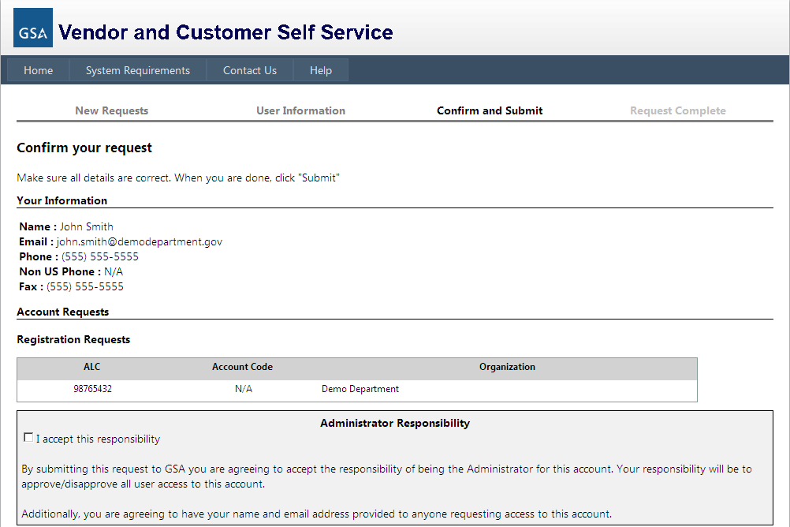
VCSS Registration Steps (Cont’d)
  On the next screen of the GSA launch page, review the registration form.
    If the information is correct, read the Administrator Responsibility text and select the I accept this responsibility checkbox.
      By selecting this checkbox, you are agreeing to become the account administrator of the VCSS account.
B8

Slide 18
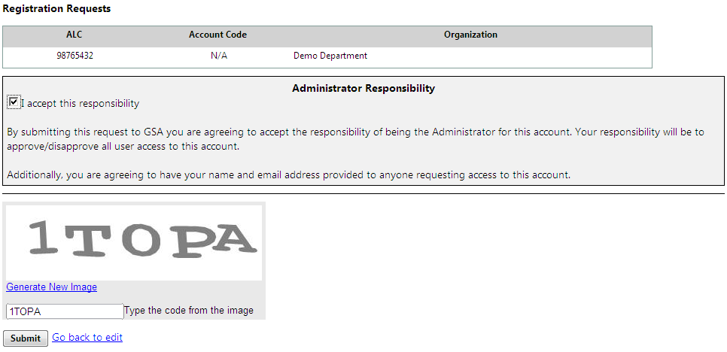
VCSS Registration Steps (Cont’d)
  At the bottom of the Confirm and Submit GSA Launch page screen, enter the code from the image and select the Submit button.
B9

Slide 19

VCSS Registration Steps (Cont’d)
GSA
  After you submit the registration, GSA is responsible for reviewing and approving the account registration request.
    If GSA approves the account registration, GSA will send you an email stating the account registration request is approved and includes a VCSS URL for new registration and a Personal Identification Number (PIN).
    If GSA does not approve the account registration, GSA will send you an email stating your account registration request is rejected.
B10
Notes:
After you submit the account registration, GSA will review your registration request for approval.

Slide 20
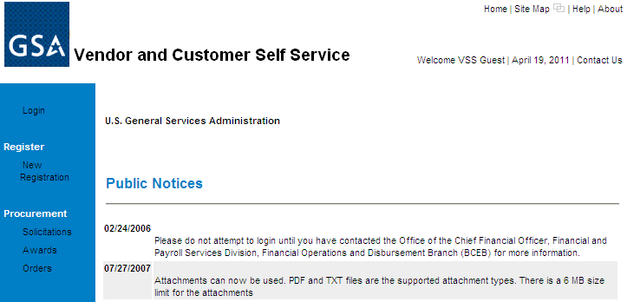
VCSS Registration Steps (Cont’d)
  Account Administrator
  As the account administrator, open the approval email from GSA and select the VCSS URL for new registration.
  On the VCSS main page, select the New Registration hyperlink.
B11
Notes:
You can only follow this step if GSA approved your registration request and sent you an approval email with the VCSS URL and PIN.

Slide 21
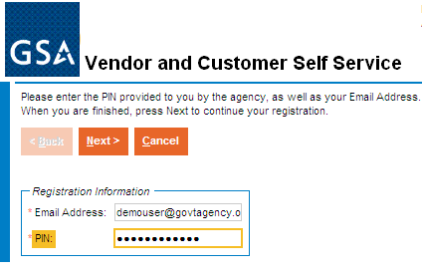
VCSS Registration Steps (Cont’d)
  On the VCSS registration page, enter the following registration information:
    Email Address you used to register on the GSA launch page’s registration form.
    PIN provided in the approval email from GSA.
    Select the [Next] button.
B12
Notes:
You can now enter the email address you used on the organization registration form and the PIN in the email from GSA.

Slide 22
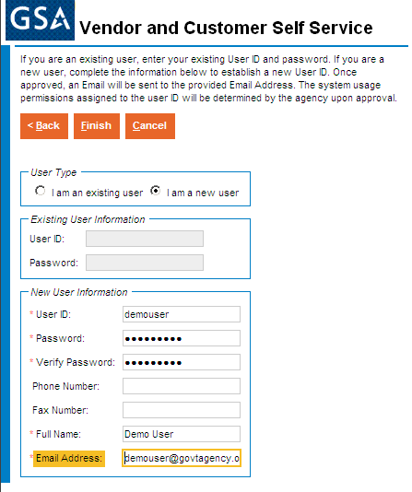
VCSS Registration Steps (Cont’d)
  On the next screen of the VCSS registration page, enter the following new user information to have a User ID created:
    User ID & Password provided in emails from GSA.
    Your contact information.
    Select the [Finish] button.
  Note: If you are an existing user, in the User Type group box, select the I am an existing user radio button, fill out your User ID and Password, and then select the [Finish] button. For example, if you have already registered a VCSS account previously, you are an existing user since you already have a User ID.
B13
Notes:
Confirm the registration information in order to have a User ID login created for you to access the VCSS customer account you just registered.

Slide 23
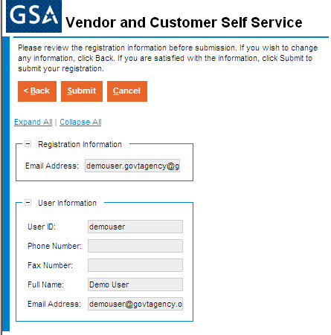
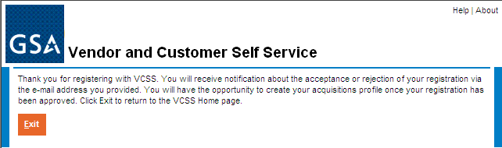
VCSS Registration Steps (Cont’d)
  On the next screen of the VCSS registration page, review the registration information and then select the [Submit] button.
demouser@govtagency.
B14
Notes:
Submit the registration information in order to have a User ID login created for you to access the VCSS account you just registered.

Slide 24
VCSS Registration Steps (Cont’d)
GSA
  After you submit the User ID registration, GSA reviews the User ID request for approval.
    If GSA approves your User ID request, GSA will send you two separate emails containing your User ID and password.
    If GSA does not approve your User ID request, GSA will send you an email stating the new User ID login request is rejected.
B15
Notes:
After you submit the registration information in VCSS, it is now in GSA hands to review your registration request and approve it.

Slide 25
VCSS Registration Steps (Cont’d)
Account Administrator
  Go to the GSA launch page and select the option to Login to VCSS to verify your User ID and password.
B16
Notes:
You can only follow this step if GSA approved your registration request and sent you two emails with your new User ID login and password.

Slide 26
VCSS Registration Steps (Cont’d)
  On the VCSS main page, select the Login hyperlink.
B17

Slide 27
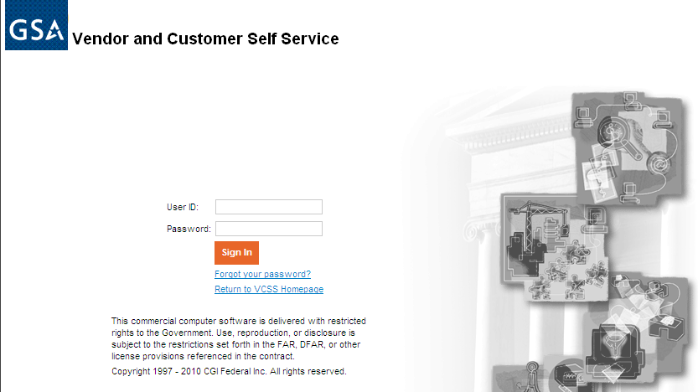

VCSS Registration Steps (Cont’d)
  On the VCSS login page, enter your login information:
    User ID and Password sent in two separate emails from GSA.
    Select the [Sign In] button.
    If your login to VCSS is successful, you now have access to the VCSS account you successfully registered for.
B18
Notes:
To login, enter your User ID and password sent in the approval email from GSA.
If the login is successful, you now have access to the VCSS customer account you just registered.

Slide 28

Request Access Overview
Request Access is the process you complete in order to request access to an existing VCSS account, which is an account that has already been registered in VCSS.
This process covers two scenarios:
    A person needs a User ID to request access to a VCSS account for the first time.
    A person already has a User ID and needs to request access to another VCSS account (account code).
  Note: The account administrator is the person that registered the VCSS account. The customer is another person requesting access to a VCSS account and is not the account administrator.
B19
Notes:
We are now going to walk through the process of how to request user access to an existing VCSS account, which is an account that has already been registered.

Slide 29
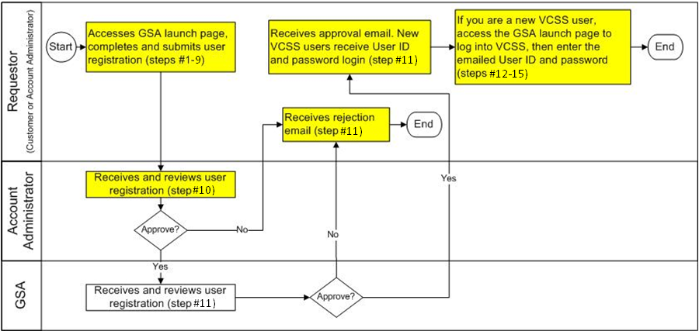
Request Access Process
This is the high level process diagram illustrating the steps to request access to an existing VCSS account.
B20
Notes:
This slide provides a high level overview of the steps taken to request access to a VCSS account. We are going to review the details for each step in this diagram in the next few slides.
Since the person requesting access can either be the customer or the account administrator, the process diagram uses the term “requestor” to refer to either of these two persons.
This is a process diagram for the request access process, which is organized with boxes and rows. Each box represents a step in the registration process. Each row is called a “swim lane” that lists the person responsible for each step.
First, the requestor, which can be the customer or account administrator that is requesting access, accesses the GSA launch page to complete and submit the user registration, which is covered in steps number 1 through 4.
Next, the account administrator, for the VCSS account you are requesting access to, receives and reviews the user registration for approval, which is covered in step number 5.
If the account administrator approves the user registration, then the access request is sent to GSA for approval.
However, if the account administrator does not approve the user registration, then the requestor receives a rejection email. Since the user registration has been rejected, the process ends here.
In the case that the account administrator approves the user registration, GSA then receives and reviews the user registration for approval, which is covered in step number 6.
If GSA approves the user registration, then the requestor receives an approval email from GSA.
However, if GSA does not approve the user registration, then the Requestor receives a rejection email from GSA. Since the user registration has been rejected, the process ends here.
In the case that the requestor receives an approval email from GSA, if you currently have a User ID, then the VCSS account that you requested access to is granted. If you do not have a User ID and are logging into VCSS for the first time, then GSA sends you a separate email with a User ID and password. You can access the GSA launch page to login to VCSS, and then enter your new User ID and password sent in the email from GSA, which is covered in steps number 7 through 10.

Slide 30
Request Access Steps
  To request access to an existing VCSS account, perform the following steps covered in the next few slides.
  As the person requesting access, go to the GSA launch page (http://vcss.gsa.gov) and select the Registrations and Access Request button to request access to an existing VCSS account.
B21
Notes:
As a customer or account administrator, you access the GSA launch page and go through the following steps.

Slide 31
VCSS Registration Steps (Cont’d)
  On the GSA launch page, select the Click here if you are a Customer of GSA button to request access to a customer account.
Non- Federal customers do not have BOAC’s or AGBU. Users should register their Account codes given to them by there GSA representative.
B22

Slide 32
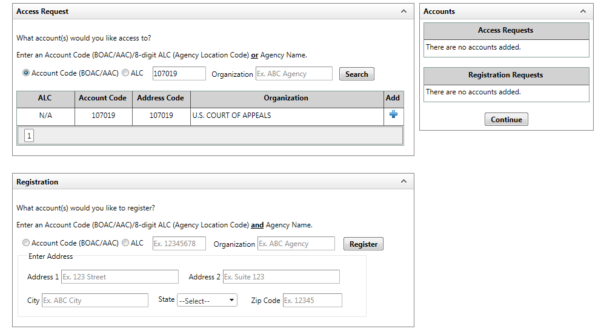
Request Access Steps (Cont’d)
  On the next screen of the GSA launch page, search for the existing VCSS account that you would like to request access to. In order to search for VCSS accounts, enter the following search criteria to identify the account:
    Account Code, ALC, or Organization.
      Select the Search button to search for existing VCSS accounts.
    Note: You may select more than one VCSS account to request access to.
B23
Notes:
If needed, you can request access to more than one account from this page.

Slide 33
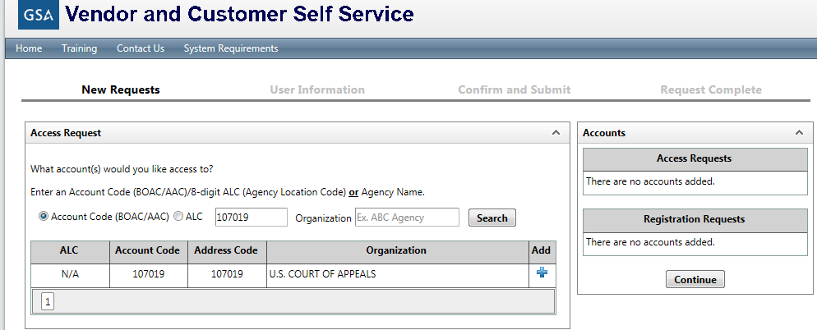
Request Access Steps (Cont’d)
  Existing VCSS accounts matching your search criteria are returned.
  Select the blue + symbol next to the account(s) you are requesting access to.
    Note: You may select more than one VCSS account to request access to.
B24
Notes:
If needed, you can request access to more than one account from this page.

Slide 34
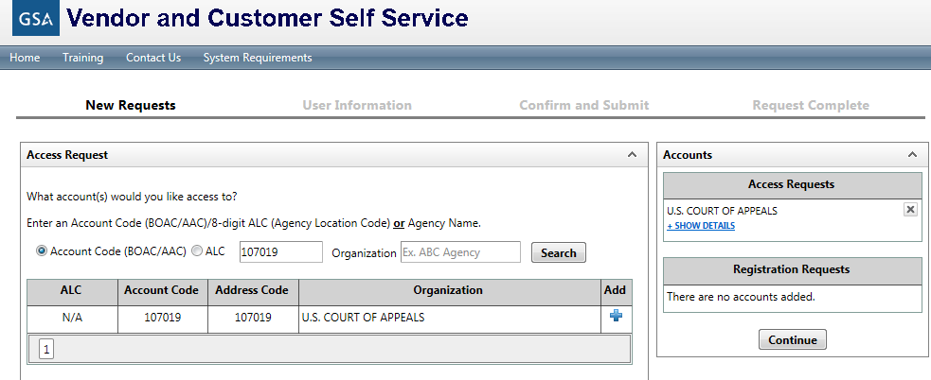
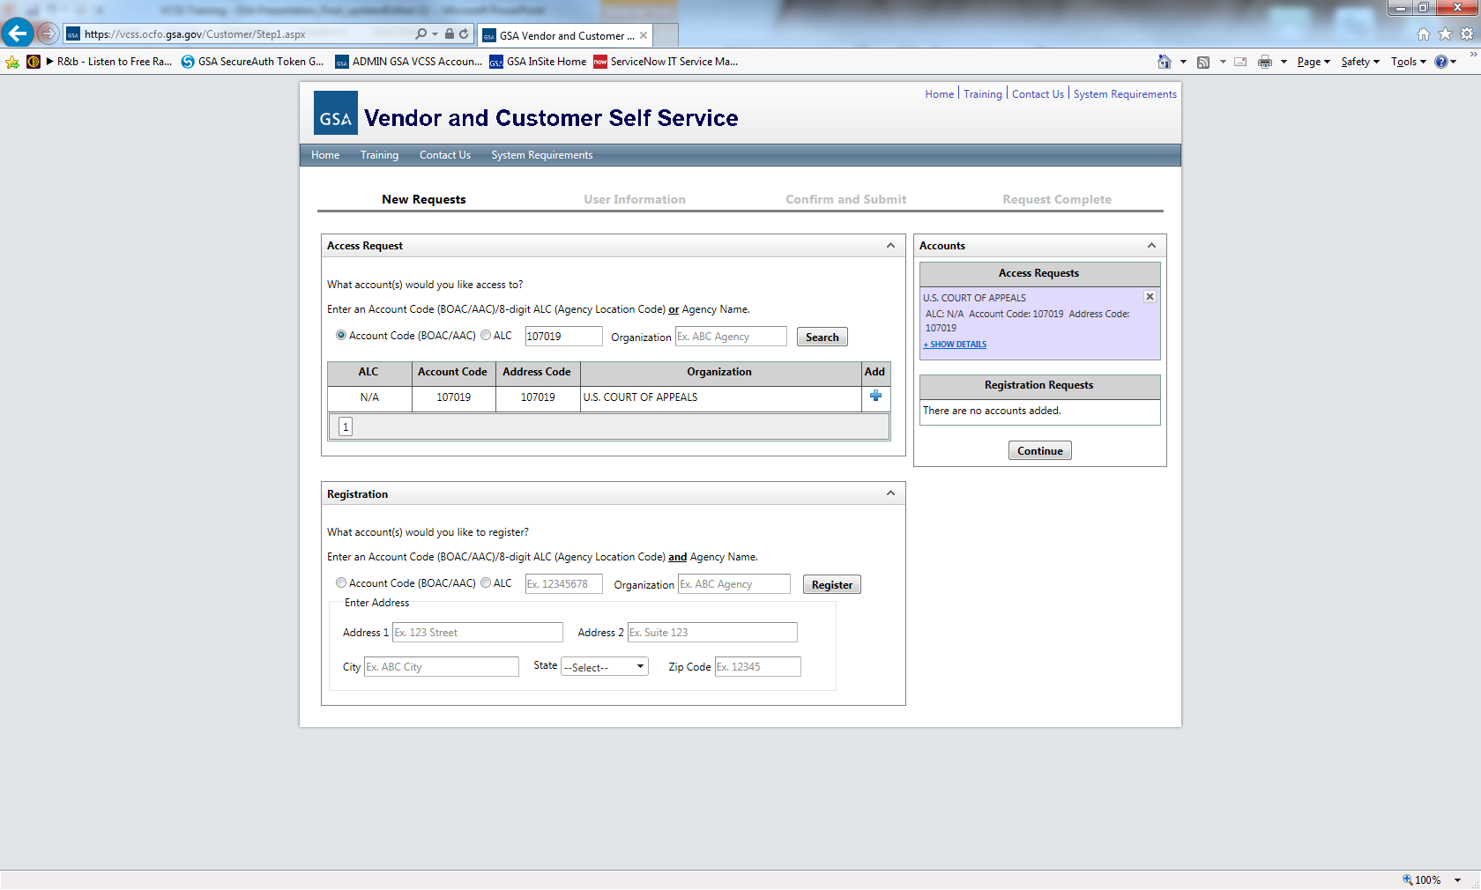
VCSS Registration Steps (Cont’d)
  The Access Requests section is populated with the Organization Name(s) associated with the account(s) you selected.
    Select +Show Details to view the details you entered for the registration.
    Select the X to remove the account and start over.
    Select the Continue button to continue the access request.
B26

Slide 35
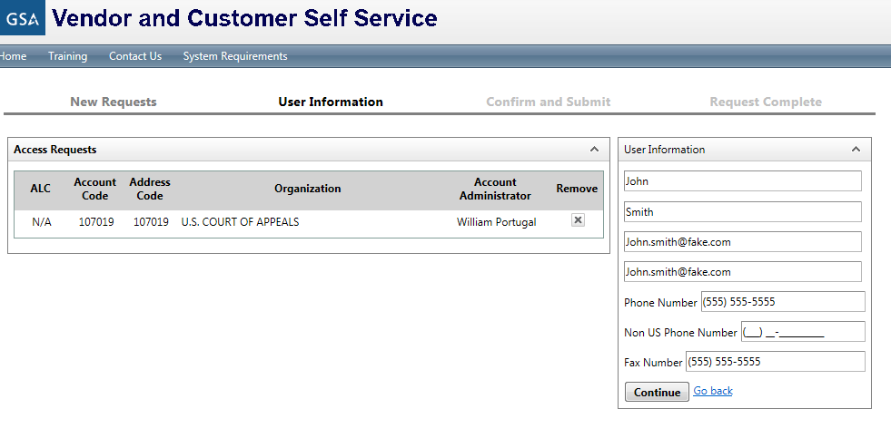
VCSS Registration Steps (Cont’d)
  On the next screen of the GSA launch page, fill out the User Information to be associated with the access request.
    Select the Continue button to continue the registration.
B27

Slide 36
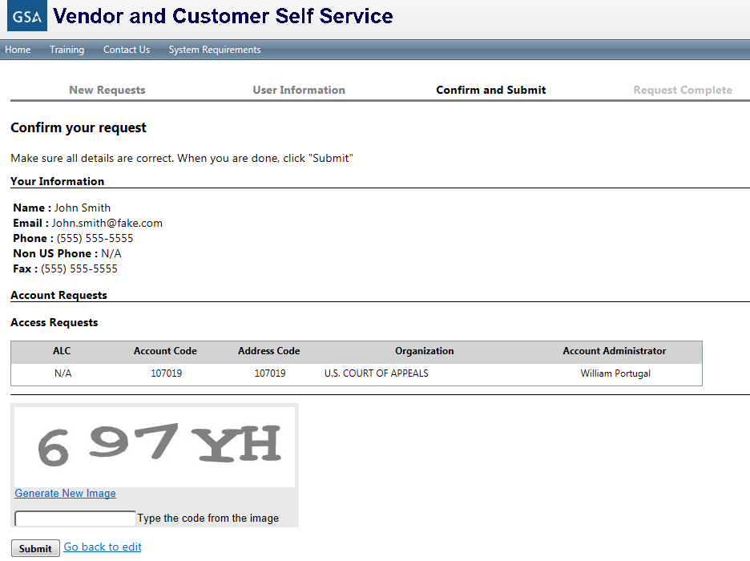
VCSS Registration Steps (Cont’d)
  On the next screen of the GSA launch page, review the access request form.
    At the bottom of the Confirm and Submit GSA Launch page screen, enter the code from the image and select the Submit button.
B28
Notes:
After you have filled out the organization registration form, you should verify the information that you entered is correct, and then submit the registration.

Slide 37

Request Access Steps (Cont’d)
Account Administrator
  After submitting the access request, the account administrator is responsible for reviewing the access request for approval.
    If the account administrator approves the access request, the access request is sent next to GSA for approval.
    If the account administrator does not approve the access request, GSA cannot approve the access request.
      The account administrator sends an access request rejection notification via email to the submitter.
B29
Notes:
It is now in the hands of the account administrator (of the account you requested access to) to review the access request for approval.
If you are the account administrator then you will receive this access request.

Slide 38
Request Access Steps (Cont’d)
GSA
  After the account administrator approves the access request, GSA is responsible for reviewing and approving the access request.
    If GSA approves the access request, GSA will do one of the following:
      If you are requesting a User ID and access to a VCSS account for the first time, GSA will send you two separate approval emails containing your User ID and password.
      If you are a customer or account administrator that already has a User ID and is requesting access to another VCSS account, GSA will send you one email stating the access request is approved.
    If GSA does not approve the access request, GSA will send you an email stating the access request is rejected.
B30
Notes:
If the account administrator has approved the access request, GSA can review the access request for approval.
GSA reviews and approves the access request.

Slide 39
Request Access Steps (Cont’d)
Customer
If you have been issued a User ID and password but have not logged into VCSS for the first time, then follow steps 12-15.
  Go to the GSA launch page (http://vcss.gsa.gov) and select the Login to VCSS option to verify your User ID and password.
B31
Notes:
If you already have a VCSS User ID, you can still access the GSA launch page to login to VCSS.

Slide 40
Request Access Steps (Cont’d)
  On the VCSS main page, select the Login hyperlink.
B32

Slide 41
Request Access Steps (Cont’d)
  On the VCSS login page, enter your login information:
    User ID and Password sent in two separate emails from GSA.
    Select the [Sign In] button.
  If your login to VCSS is successful, you now have access to the VCSS account you requested access to.
Note: At this point, you should update your security questions. We will review this process later in the presentation.
B33
Notes:
On the VCSS login page, enter your User ID and password.

Slide 42
Support Request Overview
Support requests can be created from the GSA Launch Page.
The following types of support requests can be created:
  Change Account Administrator
  Remove Account
  Remove from VCSS
  Update User Profile
B34

Slide 43
Support Request Steps
  To create a support request, perform the following steps covered in the next few slides.
  Go to the GSA launch page (http://vcss.gsa.gov) and select the Support Request button to create a support request.
B35

Slide 44
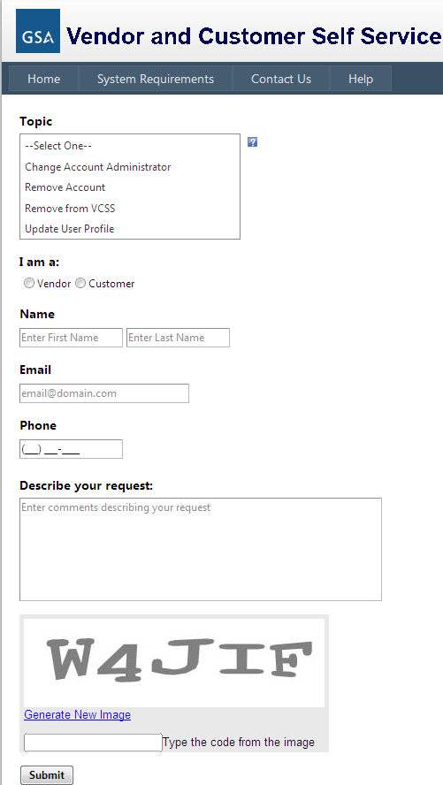
Support Request Steps (Cont’d)
Fill out the fields of the support request, including:
  Topic:
  I am a (Vendor or Customer)
  Name (first and last)
  Email
  Phone
  Describe your request
    Enter the code from the image and select the Submit button.
B36

Slide 45
References
    Return to the GSA VCSS Launch Page to access other segments of the VCSS presentation: http://vcss.gsa.gov.
  Segment 1: Introduction
  Segment 2: VCSS Account Registration & Requesting Access
  Segment 3: Basic Navigation
  Segment 4: Account Information
  Segment 5: Statement and Dispute Information
  Segment 6: Customer Payment Information
  Segment 7: Correspondence Information
  Segment 8: External Applications Information
B37
Notes:
This concludes segment 2 of the VCSS presentation.

Slide 46
Table of Contents
Segment 1: Introduction (Slides A1 - A5)
Segment 2: VCSS Account Registration & Requesting Access (Slides B1 - B37)
Segment 3: Basic Navigation (Slides C1 - C35)
  Log into VCSS
  Menu Bar and Page Layout
  Shortcuts and Other Useful Features
Segment 4: Account Information (Slides D1 - D32)
Segment 5: Statement and Dispute Information (Slides E1 - E39)
Segment 6: Customer Payment Information (Slides F1 - F23)
Segment 7: Correspondence Information (Slides G1 - G19)
Segment 8: External Applications Information (Slides H1 - H6)
Notes:
In this segment, we are going to review basic navigation in VCSS, such as:
How to login to VCSS, how pages are laid out, the menu bar, shortcuts and other useful features

Slide 47
Login to VCSS
To login to VCSS, perform the following steps:
  Go to the GSA launch page (http://vcss.gsa.gov) and select the Login to VCSS option.
  On the VCSS main page, select the Login hyperlink.
  On the VCSS login page, enter your login information:
    User ID and Password sent in two separate emails from GSA.
    Select the [Sign In] button.
C1
Notes:
You can login to VCSS via the GSA launch page.

Slide 48
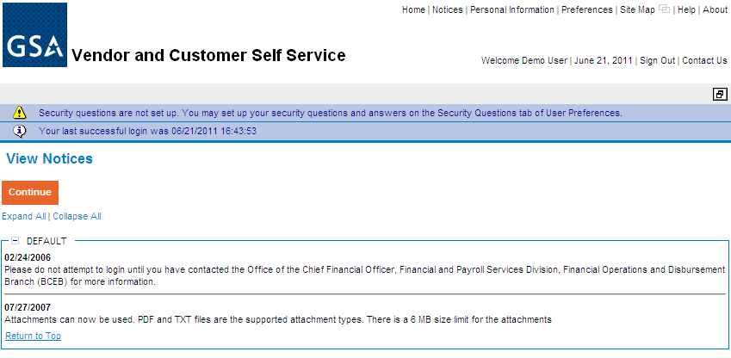
View Notices
Upon successful login, the View Notices page displays.
  Notices provide specific information, for example, notifying the customer when billings become available.
  Review notices associated with your accounts and then select the [Continue] button.
C2

Slide 49
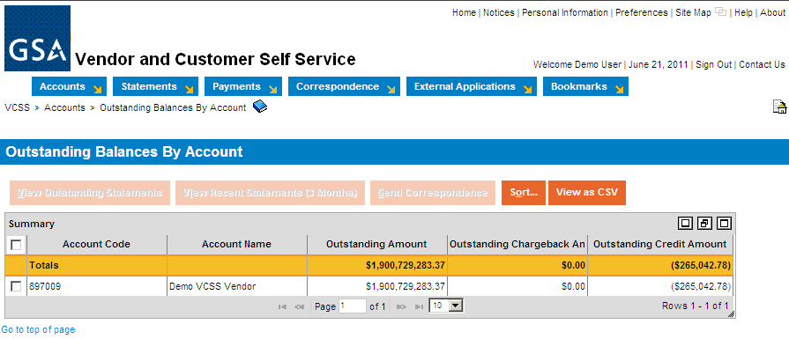
Home Page
After reviewing notices, the home page displays.
  View your outstanding balances by account.
  Access the two navigation menus that appear on most VCSS pages:
    The link strip, which is a set of clickable hyperlinks, located in the top right corner of the page.
    The menu bar, which is a horizontal row of menus, with each menu item containing a drop-down menu of additional options.
Link Strip
Menu Bar
C3
Notes:
Although the screenshot only shows a single account on the Outstanding Balances by Account page, multiple accounts could be displayed if the user has access to multiple accounts.

Slide 50
Link Strip
The link strip contains several hyperlinks to access other areas of VCSS.
  The hyperlinks include:
    Home
    Notices
    Personal Information
    Preferences
    Site Map
    New Window Icon
    Help
    About
    Sign Out
    Contact Us
C4
Notes:
Here is a list of the link strip hyperlinks to other areas in VCSS. We are now going to walk through each of these links and what they are used for.

Slide 51
Link Strip (Cont’d)
Home hyperlink
  Select the Home hyperlink to return to the home page.
  The home page is the same page that displays after you sign in to VCSS and view your notices. The home page also lists your outstanding balances by account.
C5
Notes:
In the link strip, select the Home hyperlink.

Slide 52
Link Strip (Cont’d)
Notices hyperlink
  Select the Notices hyperlink to return to the View Notices page.
  The View Notices page is the same page that displays after you sign in to VCSS.
C6

Slide 53
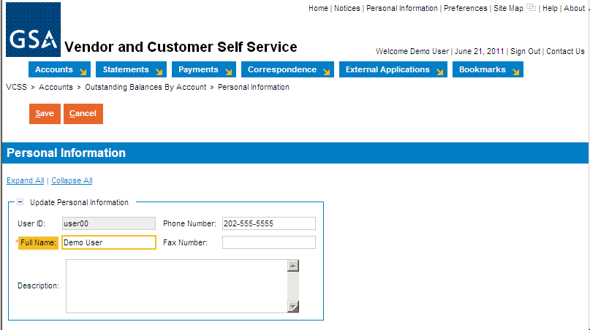
Link Strip (Cont’d)
Personal Information hyperlink
  Select the Personal Information hyperlink to maintain your personal information, which is only visible to you.
  Review your User ID, Full Name, and Phone/Fax Numbers. Only your Full Name and Phone/Fax Number can be updated if it is not correct, then select the [Save] button.
    When you create correspondence or a dispute, your information will be pulled from here.
C7
Notes:
After viewing your notices you’ll be directed to the VCSS home page. You’ll see your Outstanding Balances by Account, the Link Strip, and the Menu Bar.
Let’s go through the different hyperlinks on the link strip.
You can click on the Home page to bring you back to this page.
You can click on Notices to view notices
Next is the Personal Information link which allows you to change things like your name, phone number, fax number, or add a short description.
It is important to note that when you make changes to information, you want to make sure to select the [Save] button.
After clicking save you’ll notice that you’re brought back to your homepage and a message that action was successfully. You can now go back to the personal information and notice that its been changed.

Slide 54
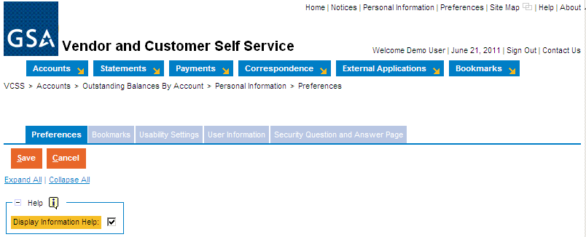
Link Strip (Cont’d)
Preferences hyperlink
  Select the Preferences hyperlink to access several settings that you can customize, organized by the following tabs:
    Select the Preferences tab to display information help when you hover over links.
    Select the Bookmarks tab to organize your bookmarks (reviewed on slide C19).
    Select the Usability Settings tab to set up keyboard shortcuts and customize your experience in VCSS (e.g. set the ‘auto tab’ feature so that when you fill out a form in VCSS, your cursor automatically moves to the next field).
    Select the User Information tab to reset your password and update your email(your email entered here will be used for correspondence.
C8
Notes:
Next is the preferences link. You’ll see various tabs that you can access.
Access several settings to customize your experience in VCSS.
Select a Preferences tabs to change settings.

Slide 55
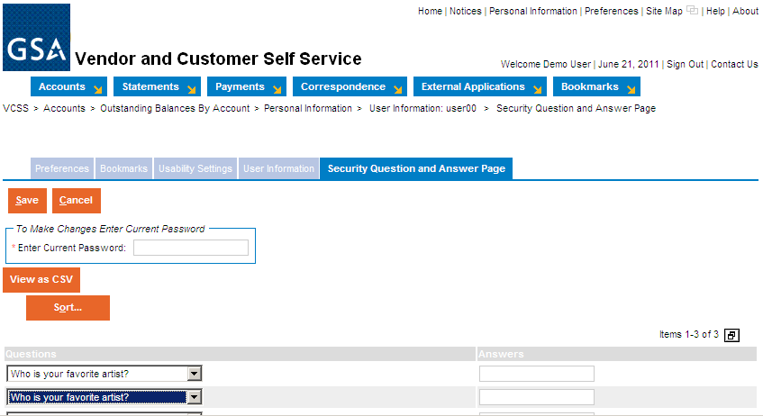
Link Strip (Cont’d)
Preferences hyperlink
  Select the Security Question and Answer Page tab to set up security questions and answers as a password retrieval tool. This is not required but is helpful to set up if you would like to be able to recover your password if you forget it.
C9
Notes:
This is a password retrieval tool that is highly recommended that you set up in the case you lose your password.

Slide 56
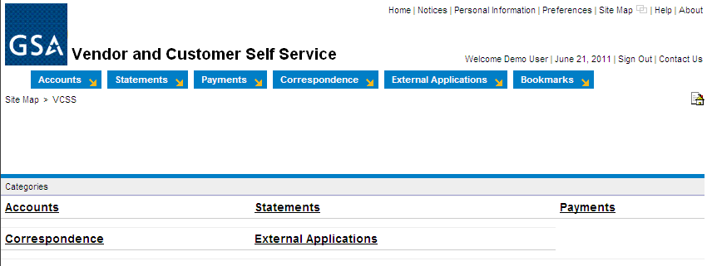
Link Strip (Cont’d)
Site Map hyperlink
  Select the Site Map hyperlink to view a list of the menu bar options as clickable hyperlinks.
  This is an additional navigation tool to navigate through the hyperlinks as an alternative to using the actual menu bar.
C10

Slide 57
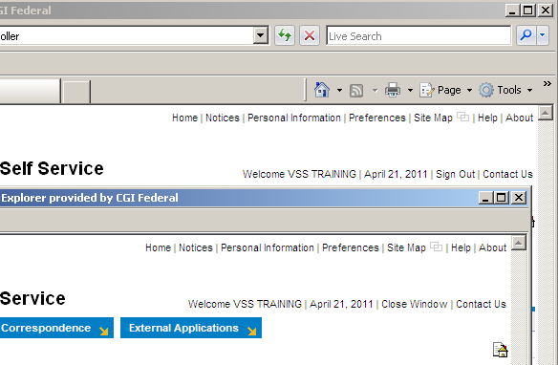
Link Strip (Cont’d)
New Window Icon
  There is a square-shaped icon in the link strip called the new window icon (next to the Site Map hyperlink).
    Select the new window icon to open a new window of the same session of VCSS, while the current window you are working in also remains open at the same time.
  Just like internet explorer, you have the ability to open multiple windows.
    Place the windows side by side or switch back and forth between them, giving you the ability to look something up while you are working on something else.
    Your original window has the Sign Out hyperlink in the link strip, while your new window has the Close Window hyperlink.
  Note: Do not use your browser’s X to close the window. Instead, select the Close Window hyperlink to close the window.
Demo User
Demo User
C11
Notes:
For example, let’s say you are requesting a dispute to send to GSA because you think one of your statements might be in error. While you are going through the dispute process and entering dispute information, you can select the new window icon, open up a new window, and view the actual statement as reference. While you are reviewing the statement, the dispute process window still remains open. When you are finished reviewing the statement, select the Close Window hyperlink in the new window, then go back to the dispute process window that you are working in.
It is important to know that you should not use the Internet Explorer navigation options. Do not use the Back button or use the X to close the window. Instead, you need to use the Close Window hyperlink to close a window.

Slide 58
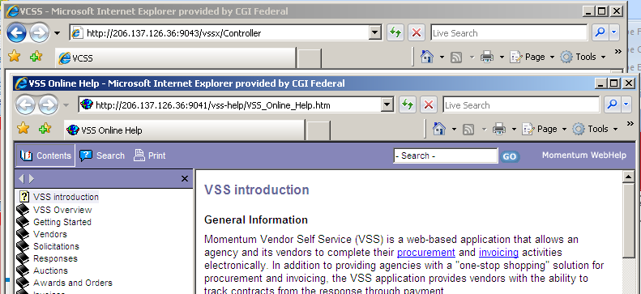
Link Strip (Cont’d)
Help hyperlink
  Select the Help hyperlink to open a new window with GSA’s VCSS help documentation, where you can do the following:
    Search for help content, organized by topic.
    Learn more about VCSS and navigation.
Note: This screenshot is currently what is available in VCSS and will be updated.
C12

Slide 59
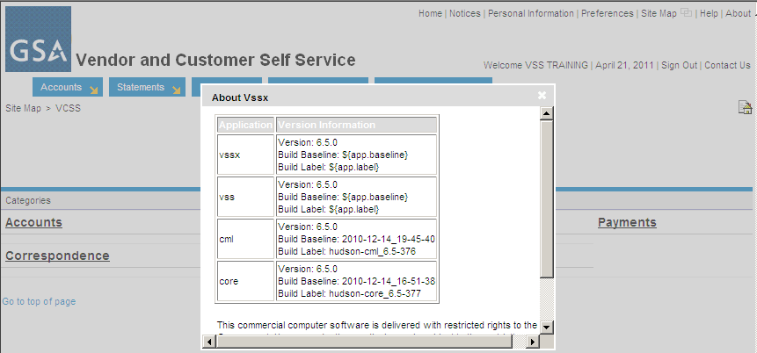
Link Strip (Cont’d)
About hyperlink
  Select the About hyperlink to view the VCSS version information.
Demo User
C13

Slide 60

Link Strip (Cont’d)
Sign Out hyperlink
  Select the Sign Out hyperlink to exit VCSS.
  Upon signing out of VCSS, the VCSS exit page displays a clickable hyperlink to return to the VCSS login page.
Close Window hyperlink
  Select the Close Window hyperlink to close the window and return to the previous window.
  Displays only on new windows that have been opened.
Demo User
Demo User
C14

Slide 61
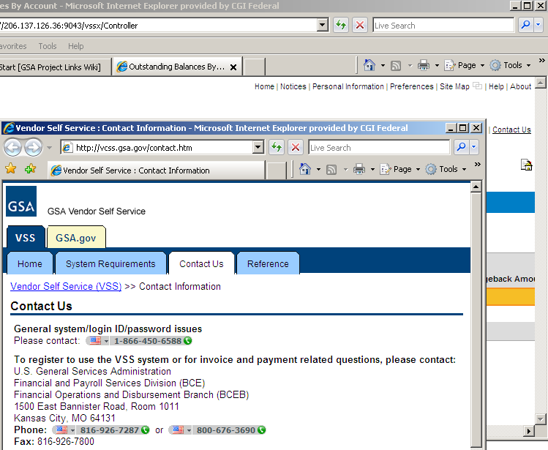
Link Strip (Cont’d)
Contact Us hyperlink
  Select the Contact Us hyperlink to access GSA contact information for VCSS.
Note: The GSA Contact Us page will display the appropriate GSA contact information for both vendors and customers.
C15

Slide 62
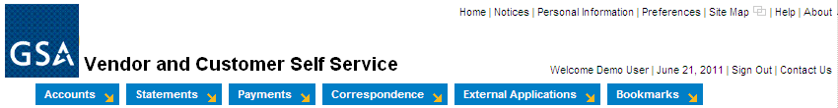
Menu Bar
Use the menu bar to navigate through your account and access account information.
  Each menu item contains a drop-down list of menu options, grouped by function.
  These menu items will be covered in separate sections of this presentation, as indicated below.
    Accounts (segment 4)
    Statements (segment 5)
    Payments (segment 6)
    Correspondence (segment 7)
    External Applications (segment 8)
C16
Notes:
Here is a list of the menu bar options that display in the menu bar. This is how you navigate through your account and account information. This menu bar is static and remains on the home page of VCSS.
We are going to walk through each of these in separate sections of this training, after we finish going through basic navigation.

Slide 63
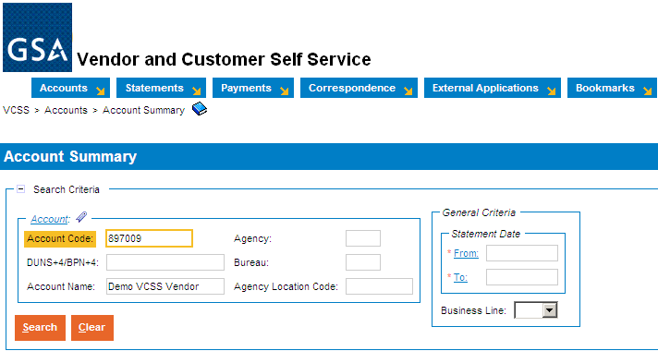
Breadcrumbs
Breadcrumbs show the path to the current page you are on.
  Breadcrumbs include hyperlinks that represent the most likely path you might have followed to navigate to the current page you are on.
  Located at the top of the page, below the menu bar, on various pages throughout VCSS.
  Select a hyperlink in the breadcrumbs to return to a previous page, since you cannot use the back button in your browser.
    For example, if you are on the Account Summary page, the breadcrumbs display showing the most common path to navigate to the Account Summary page. In this case, the Account Summary page is accessed from the Accounts menu.
C17
Notes:
For example, let’s say you selected the Accounts menu bar, then the Account Summary option. The breadcrumbs trail now shows you the Account Summary hyperlink which is the page you are now on. Since the Account Summary option is within the Accounts menu bar, the Accounts hyperlink displays too.

Slide 64

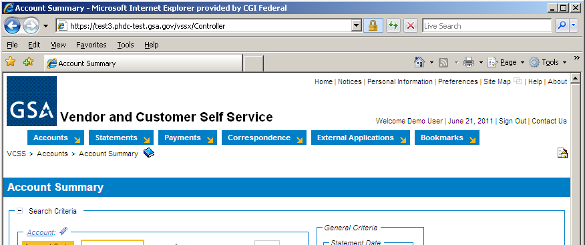
Breadcrumbs (Cont’d)
Internet Explorer Browser Navigation
  To navigate within VCSS, do not use your browser’s navigational tools, which includes the back button and the X used to close the window.
    If you use your browser’s navigational tools accidentally, you will be signed out of VCSS and risk losing your work.
    Instead, use the VCSS navigation tools, which are the breadcrumbs, menu bar, and link strip.
C18
Notes:
Point out the back button and the X in Internet Explorer to point out that you should not use Internet Explorer navigational options (i.e. Back button) to navigate within VCSS.

Slide 65
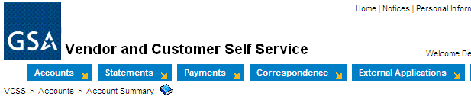
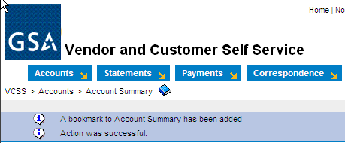
Bookmarks
If you access a specific page frequently in VCSS (e.g. the Account Summary page), then add that page as a bookmark to access quickly at a later time.
If the page can be added as a bookmark, then the bookmark icon is located to the right of the breadcrumbs.
Bookmarks in VCSS work similarly to favorites in internet explorer.
Add a Bookmark
  To add a bookmark, select the bookmark icon on the page you want to add as a bookmark.
  A system message displays confirming the bookmark has been added.
C19
Notes:
If you access a specific page frequently in VCSS, (e.g. the account summary page), then add that page as a bookmark to access quickly a later time.
Bookmarks in VCSS work similarly to adding a favorite in Internet Explorer.

Slide 66
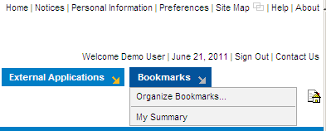
Bookmarks (Cont’d)
Access a Saved Bookmark
  Once you add a page as a bookmark, the Bookmarks menu item displays in the menu bar.
    If you have not added a bookmark, the Bookmarks menu does not display.
  To access the saved bookmark, from the menu bar select Bookmarks > [Name of bookmark].
C20
Notes:
Your bookmarks remain from one login session to the next.

Slide 67

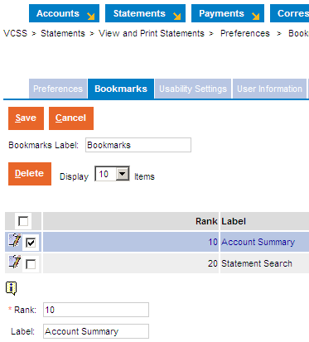
Bookmarks (Cont’d)
Organize Saved Bookmarks
  Once you have added a few bookmarks, you can organize your bookmarks from the menu bar by selecting Bookmarks > Organize Bookmarks.
  Bookmarks display in the Bookmarks menu in the order in which they were added. To re-order bookmarks, select a bookmark and update the Rank field.
  To re-name a bookmark, select the bookmark and update the Label field.
  To remove a bookmark, select the bookmark and select the [Delete] button.
  To save updates, select the [Save] button.
C21
Notes:
Once you have added a bookmark, you can organize your bookmarks by changing the name of the bookmark. If you have more than one Bookmark, you can re-order how the bookmarks display in the Bookmarks menu.

Slide 68
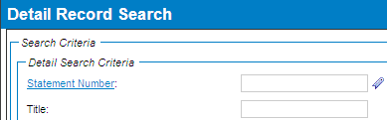
Hyperlinks
Blue underlined hyperlinks that list the name of a field, display on many pages.
  Select the hyperlink to access a search page to search for values to enter in that specific field.
    This can be helpful if you cannot remember a value to enter in a field. Instead, you can select the field’s hyperlink and then search for values. The hyperlinks work as a lookup to find the value you need to enter in that field.
    For example, if you need to enter a statement number and you cannot remember the specific statement number to enter, select the Statement Number hyperlink. You are then taken to a search page to search for statement numbers. Once you find the statement number you need, select the statement number to enter in the Statement Number field.
C22
Notes:
Throughout VCSS, you come across blue underlined text, which is a clickable hyperlink. Many of these hyperlinks are the label next to a specific field, and when you select the hyperlink, you access a search page to search for values that can be used in that specific field.
For example, if you need to enter a specific statement number in VCSS, the Statement Number field is a blue hyperlink, meaning you can select it. When you select the Statement Number hyperlink, you access a search page to search for statement numbers associated with your account.
This can be helpful if you cannot remember specific values to put in a field. Instead, you can select the hyperlink to search for a particular value to put in the field.
We can review an example of selecting a hyperlink later in the training.

Slide 69
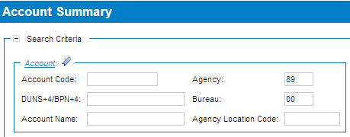
Favorites
Favorites are frequently used values that can be saved.
  Favorites are a feature of VCSS that will be available in a future release.
  If you use a value frequently, then you can designate it as a favorite.
  Favorites can be added to fields that include the favorites icon next to it, which looks like a small clothes-pin. Favorites are added by you only and remain from one login session to the next.
  For example, if you have access to more than one account, designate a specific account as a favorite, by selecting the favorites icon and adding your account as a favorite.
C23
Notes:
For example, let’s say you need to search for information on one of your accounts frequently. If you add the account code as a favorite, then you can select it from the list of favorites, instead of typing the account code in by memory, and it populates the saved value in the account code field. These favorites that you add will remain saved from one login session to the next. They can only be removed by you, using the trashcan icon.
Favorites will be available in a future release.

Slide 70
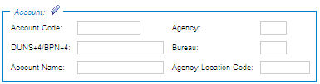

Favorites (Cont’d)
Add a Favorite
  Select the favorites icon next to the field.
  In the favorites pop-up window, select the Search hyperlink to search for field values (in this example search for account values).
C24
Notes:
Any field with a favorites icon next to it, means that you can add favorite values to be used in this field on different pages within VCSS.
Select the favorites icon next to a field to view the favorites pop-up window.
The favorites pop-up window will display any favorite values you have already added previously. Since we have not added any favorites yet, this favorites pop-up window is empty. There is always a Search hyperlink available to search for new values to be added as favorites.

Slide 71
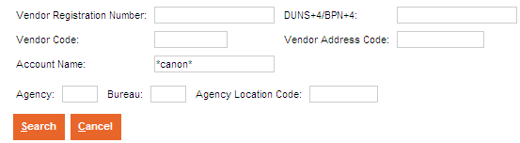
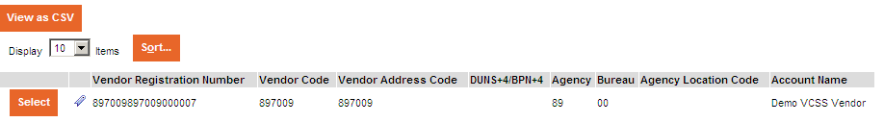
Favorites (Cont’d)
Add a Favorite
  On the search page, enter search criteria to search for valid values and then select the [Search] button.
  In the search results, select a record to add the value as a favorite by selecting the favorites icon next to the record.
    You can add multiple favorites.
C25
Notes:
After selecting the Search hyperlink in a favorites pop-up window, you will be taken to a search page to search for values that can be used in the field that you selected the favorites icon next to.
After running your search for favorite values, in the search results the values that met your search criteria display. Select the favorites icon next to a value that you would like to have added as a favorite for the field. Upon selecting the favorites icon, the search page refreshes and the value is added to the fields’ favorites pop-up window.

Slide 72
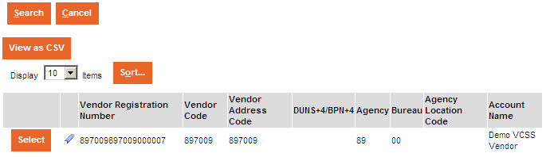
Favorites (Cont’d)
Add a Favorite
  Once you have added favorites for a field, to return to your previous page you can do either of the following:
    Click the [Select] button, which fills in the field with the selected record information, or,
    Click the [Cancel] button, which does not fill in the field with the selected record information.
C26
Notes:
To leave the search page and return to the page with the field where you selected the favorites icon next to, you have two options.

Slide 73
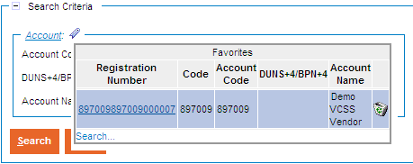
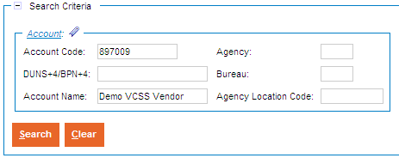
Favorites (Cont’d)
Access a Saved Favorite
  Select the favorites icon next to the field that you added favorites for.
  The favorites pop-up window displays with the favorite values you added.
  Simply select the favorite record to populate the field with the favorite record value.
  The field is now populated with the favorite record values.
  In the example below, the account we previously added as a favorite is now populated in the appropriate account fields.
C27
Notes:
When you select the favorites icon next to the field you added the favorites for, the favorites pop-up window displays with the favorites value that you added.
In most instances, when this field displays in other pages of VCSS, select the favorites icon next to the field and you will see your favorite values display.

Slide 74
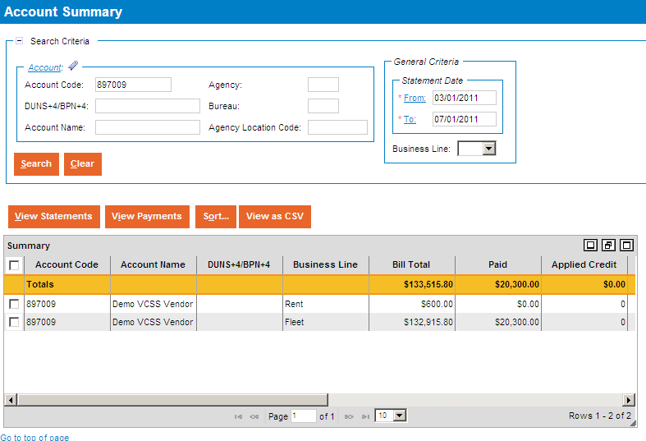
Standard Page Layout
Below is an example of a standard page layout for most pages in VCSS. Not every page follows this exact layout.
The top portion of the page has an area referred to as “search criteria”.
The bottom portion of the page has an area referred to as “search results”.
search criteria
search results
C28

Slide 75
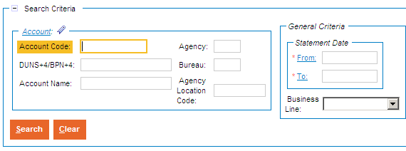
Standard Page Layout (Cont’d)
Search Criteria
  In the search criteria area of the page, enter values in the search criteria fields to filter the search results that return, and locate the information you need.
    If there are many records for the system to filter through, entering more search criteria can shorten the time it takes for the system to return records.
  Most search criteria fields that are required will be marked with a red asterisk (*).
  Use the wildcard character (*) to ease searching (this is covered on the next slide).
  When you finish entering search criteria, select the [Search] button to run the search.
C29

Slide 76

Standard Page Layout (Cont’d)
Wildcard (*)
  The wildcard character can be optionally used in search criteria fields and substitutes a character or group of characters.
  You can add the wildcard at the beginning, middle, or end of a value. You can also add more than one wildcard character in a search field.
    For example, if you want to search for a correspondence that has the subject line “Info about your statement”, then enter the following in the subject search criteria field:
      Wildcard at the beginning (*info), middle (info*statement), or end (info*).
      Add more than one wildcard (*info*).
C30
Notes:
We will run through an example using the wildcard (*) character, which will really help with searching.
You can use more than one wildcard (*) character in a search field.

Slide 77

Standard Page Layout (Cont’d)
Search Results
  The search results area of the page consists of rows of data called “records” that met the search criteria.
    In some cases, a “Totals” row displays that gives you the total amount of that column (the Totals row displays total amounts for all records that meet the criteria, not just those being displayed).
    Search results can display up to 1,000 records at a time.
  Here are some options that you have to change how your search results display:
    Minimize and maximize the search results list.
    Use the scrollbars to scroll through the records.
    Adjust column width by dragging the vertical column lines.
    Change the number of records that display at once (10, 20, 50, 100, ALL).
    Change the size of the search results by using the drag-able corner in the bottom right.
C31
Notes:
You can always review search results in the search results area, with many options to change your view of the search results.

Slide 78
Standard Page Layout (Cont’d)
Search Results
  In the search results, there are action buttons that display directly above the records. These action buttons tell you what you can do with the records.
    The [Sort] button is a common action button used to sort all the records in the search results by column heading.
    The [View as CSV] button is also a common action button used to export the records in the search results to a Comma Separated Value (CSV) file.
  In addition, when you select a record in the search results, there may be action buttons that become available and are specific to the record selected.
    For example, the [View Statements] and [View Payments] buttons are grayed out until you select a record. When you select a record, you can view statements and payments for that record.
C32
Notes:
When you select a record in the search results, there will be action buttons available to perform for that record selected.
Two common action buttons you will see are the [Sort] button and the [View as CSV] buttons.

Slide 79

Standard Page Layout (Cont’d)
Sort Records
  If there is a [Sort] button in the search results, then you have the option to sort the records by up to three columns.
  You do not need to select a specific record in order to select the [Sort] button, since all records are sorted.
    Select the [Sort] button.
    Select a Sort by column, then the Ascending or Descending radio button.
    Select the [OK] button to sort the records.
  You can also sort individual columns by selecting a column heading to sort in ascending order. Select the column heading a second time to sort in descending order.
C33
Notes:
If there are multiple records, you can sort them by a specific column heading in ascending or descending order.
This can be really helpful there are many records and you want to specify the particular values you want to see.

Slide 80

Standard Page Layout (Cont’d)
Export Records
  If there is a [View as CSV] button in the search results, then you can export the records to a Comma Separated Value (CSV) file format, which can be opened in a Microsoft Excel spreadsheet.
  You do not need to select a specific record in order to select the [View as CSV] button, since all records are exported.
    Select the [View as CSV] button.
    In the file download pop-up window, select the [Open] button to open the CSV file.
  Note: Depending on your browser settings, you might need to allow pop-ups to use this view as CSV feature.
C34
Notes:
If there are multiple records, you can export the records to a CSV file that can be opened in an Excel spreadsheet.

Slide 81
References
    Return to the GSA VCSS Launch Page to access other segments of the VCSS presentation: http://vcss.gsa.gov.
  Segment 1: Introduction
  Segment 2: VCSS Account Registration & Requesting Access
  Segment 3: Basic Navigation
  Segment 4: Account Information
  Segment 5: Statement and Dispute Information
  Segment 6: Customer Payment Information
  Segment 7: Correspondence Information
  Segment 8: External Applications Information
C35
Notes:
This concludes segment 3 of the VCSS presentation.

Slide 82
Table of Contents
Segment 1: Introduction (Slides A1 - A5)
Segment 2: VCSS Account Registration & Requesting Access (Slides B1 - B37)
Segment 3: Basic Navigation (Slides C1 - C35)
Segment 4: Account Information (Slides D1 - D32)
  Search and View Account Information
  Review Balances
Segment 5: Statement and Dispute Information (Slides E1 - E39)
Segment 6: Customer Payment Information (Slides F1 - F23)
Segment 7: Correspondence Information (Slides G1 - G19)
Segment 8: External Applications Information (Slides H1 - H6)
Notes:
In Segment 4 we will be going over how to search and view account information, as well as review balances.

Slide 83
Accounts Menu
Account Information or Account Search
  If you have access to only one account, then the Account Information menu option displays. This will review general information of your account.
  If you have access to more than one account, then the Account Search menu option displays. You can search for the account you would like to review information on.
Account Summary
  Review balances for your accounts.
Outstanding Balances by Account
  Review a list of outstanding balances for your accounts. (This page is the same as the home page).
Business Line Summary
  Review account balances sorted by GSA business line (i.e. Rent and Fleet).
D1
Notes:
We are now going to walk through each of these Accounts menu bar options in this section.

Slide 84

Account Information
The Account Information page is used to display your account information details.
  If you have access to only one account, your account information automatically displays.
  To access the Account Information page, from the menu bar select Accounts > Account Information.
  Note: If you have access to more than one account, there is an extra step to search for an account first which is covered on the next slide
D2
Notes:
The Account Information option displays in your Accounts menu bar if you have access to one account.
Access the Account Information page from the menu bar.

Slide 85

Account Search
The Account Search page is used to search for a list of your accounts.
  If you have access to more than one account, you must first search for your accounts, and then select a specific account to view account information details.
  To access the Account Search page, from the menu bar select Accounts > Account Search.
D3
Notes:
The Account Search option displays in your Accounts menu bar if you have access to more than one account.
Access the Account Search page from the menu bar.

Slide 86

Account Search (Cont’d)
Account Search page
  The Account Search page displays with a search criteria area to search for your accounts.
  Select the [Search] button without entering search criteria.
    If you have access to a large number of accounts, you may want to enter search criteria and select the [Search] button to limit the search results to a manageable number.
    If you have access to a single account, you will see the Account Information page rather than the Account Search Page.
D4
Notes:
Here is the Account Search page. If you have access to only a few accounts, select [Search] without entering in any search criteria. This will display all of your account records in the search results.

Slide 87

Account Search (Cont’d)
Account Search page
  In the search results, review a list of accounts that met your search criteria. If you did not enter any search criteria, the list will show all of the accounts to which you have access.
D5
Notes:
This shows the results of your search, containing account records.

Slide 88

Account Search (Cont’d)
Account Search page
  To view detailed information for an account record, in the search results select an account record and then select the [View] button.
D6
Notes:
View the account record details. From this page, here are the action buttons available for each account record. To open the account information, select a record and then select [View].

Slide 89

Account Information or Search
Account Record
  If you have access to one account, when you select the Account Information option from the menu bar, your account record displays with detailed account information.
  If you have access to more than one account, you must first search for your accounts, select a specific account record, and then select the [View] button to display your account record with detailed account information.
  The account record opens and displays in a tab-like format. The first tab is the Account Information tab and contains general account information.
D7
Notes:
The account record displays after accessing the Account Search page to search for your account first, and then selected a record and selected the [View] button.
The account record also displays after accessing Account Information from the menu bar, if you have access to only one account.

Slide 90

Account Information or Search (Cont’d)
Account Record
  Within the account record, select the Address Information tab to review the mailing, physical, and remittance addresses that belong to this account.
D8

Slide 91

Account Information or Search (Cont’d)
  User tab
    Within the account record, select the User tab to review every user that has access to this account.
D9

Slide 92

Account Summary
The Account Summary page is used to search for and view summary information about your accounts.
  View summary information such as bill total, paid, closed, and outstanding amounts.
  Also, view statements and payments associated with an account.
    Viewing statements and payments can be done from the Account Summary page. Statements and payments can also be accessed from the Statements and Payments menu options.
  To access the Account Summary page, from the menu bar select Accounts > Account Summary.
D10
Notes:
The Account Summary page is used to search for and view a summary of your account balances.

Slide 93

Account Summary (Cont’d)
Account Summary page
  The Account Summary page displays with a search criteria area to search for summary information on your accounts.
  Enter search criteria and select the [Search] button.
D11
Notes:
The Account Summary page displays, with a search area to enter search criteria to search for account summary records.

Slide 94

Account Summary (Cont’d)
Account Summary page
  In the search results, review your account summary record(s).
Note: The amounts displayed in the search results are what is available in VCSS and restricted by what was entered in the search criteria fields when queried.
D12
Notes:
After running the search for account summary records, review the search results in the search results.
We are now going to review how to view associated statements and payments with an account summary record.

Slide 95

Account Summary (Cont’d)
Account Summary page
  To view statements associated with an account summary record, select an account summary record and then select the [View Statements] button.
D13
Notes:
All history will be available for statements and Cash Receipts (CRs).

Slide 96

Account Summary (Cont’d)
Statement Search page
  The Statement Search page displays with the option to search for statements associated with the selected account summary record.
    To search for statement records, enter search criteria and select the [Search] button.
    In the search results, review the statement records that display.
D14

Slide 97

Account Summary (Cont’d)
Account Summary page
  To view payments associated with an account summary record, select an account summary record and then select the [View Payments] button.
D15
Notes:
Payment Authorizations (IPs) will only be available from when the customer was registered.

Slide 98

Account Summary (Cont’d)
Payment Search page
  The Payment Search page displays with the option to search for payments associated with the selected account summary record.
    To search for payment records, enter search criteria and select the [Search] button.
    In the search results, review the payment records that display.
D16
Notes:
The Payment Search page displays where you can search for payments associated with the selected account summary record.

Slide 99

Outstanding Balances by Account
The Outstanding Balances by Account page is used to review outstanding balances for your accounts.
  View outstanding balances, such as chargeback amounts and credit amounts.
  View outstanding statements.
    “Outstanding statements” are statements with an outstanding or unpaid balance greater than $0.
  View recent statements.
    “Recent statements” are statements from within the last three months.
  Also, create account correspondence to send to GSA.
    Account correspondence are messages regarding a general issue or question on your VCSS account. This correspondence should not be related to a specific statement, refund or payment on your. Please contact your Contracting Officer to discuss statement, payment or refund questions.
    To access the Outstanding Balances by Account page, from the menu bar select Accounts > Outstanding Balances by Account.
D17

Slide 100

Outstanding Balances by Account (Cont’d)
Outstanding Balances by Account page
  The Outstanding Balances by Account page displays, with a list of your account(s) by outstanding balance.
    The Outstanding Amount column is the total outstanding amount of statements.
    The Outstanding Credit Amount column is outstanding credits the customer has.
D18
Notes:
The Outstanding Amount column is the total outstanding amount of statements. The Outstanding Chargeback column is for IPAC statements only that have been charged back. The Outstanding Credit Amount column is outstanding credits the customer has.
We are now going to review the options on this page.

Slide 101

Outstanding Balances by Account (Cont’d)
Outstanding Balances by Account page
  To view outstanding statements on your account, select an account record and then select the [View Outstanding Statements] button.
D19
Notes:
Outstanding statements are statements with an outstanding amount greater than $0.

Slide 102

Outstanding Balances by Account (Cont’d)
Statement Search page
  The Statement Search page displays with outstanding statement records already shown in the search results.
  From this page you can select a statement record and then:
    Select the [View] button to view the statement details, or
    Select the [View PDF] button to view a PDF version of the statement.
D20

Slide 103
Outstanding Balances by Account (Cont’d)
Outstanding Balances by Account page
  To view recent statements on your account, select an account record and then select the [View Recent Statements (3 Months)] button.
D21
Notes:
Recent statements are statements from within the last three months.

Slide 104
Outstanding Balances by Account (Cont’d)
Statement Search page
  The Statement Search page displays with recent statement records in the search results.
  From this page you can select a statement record and then select the [View] button to view the statement details or select the [View PDF] button to view a PDF version of the statement.
D22

Slide 105
Outstanding Balances by Account (Cont’d)
Outstanding Balances by Account page
  To create correspondence to send to GSA, in the search results select an account record and then select the [Send Correspondence] button.
D23
Notes:
From here, you can create correspondence to send to GSA regarding a general issue or question on one of your accounts.

Slide 106

Outstanding Balances by Account (Cont’d)
Send Correspondence page
  The Send Correspondence page displays. To send correspondence to GSA, fill out the following information:
    Your contact, account, and correspondence information.
    Add an attachment, if needed (file types supported are text, PDF, Microsoft Excel and Word documents).
    Select the [Submit Correspondence] button to send the correspondence to GSA. Once submitted, GSA will receive and review this correspondence.
D24
Notes:
The Send Correspondence page displays where you can enter the correspondence information, and some fields may automatically default.
In the Contact Person fields you enter your contact information.
In the Account fields enter your account information.
In the Correspondence fields enter your message.
Add an attachment to support your correspondence, if needed.
When you are ready to send your correspondence to GSA, select the [Submit Correspondence] button.
We will cover how to create and send account correspondence in more detail in the Correspondence section of this presentation.

Slide 107

Business Line Summary
The Business Line Summary page is used to search for and view balances for your accounts, with data grouped by the business lines in GSA.
  View business line balances, such as total statement amounts, paid amounts, outstanding amounts, and credit amounts.
  Also, view statements and payments associated with a business line summary record.
    To access the Business Line Summary page, from the menu bar select Accounts > Business Line Summary.
D25

Slide 108

Business Line Summary (Cont’d)
Business Line Summary page
  The Business Line Summary page displays with a search criteria area to search for account records sorted by business line.
  Enter search criteria and select the [Search] button.
D26
Notes:
The Business Line Summary page displays, with a search area to enter search criteria to search for business line summary records.

Slide 109

Business Line Summary (Cont’d)
Business Line Summary page
  In the search results, review the list of business line summary records.
D27

Slide 110

Business Line Summary (Cont’d)
Business Line Summary page
  To view statements for a business line summary record, select a business line summary record and then select the [View Statements] button.
D28
Notes:
To review statements for a business line summary record, select the [View Statements] button.

Slide 111
Business Line Summary (Cont’d)
Statement Search page
  The Statement Search page displays with statement records in the search results.
  From this page you can select a statement record and then select the [View] button to view the statement details or select the [View PDF] button to view a PDF version of the statement.
D29
Notes:
The Statement Search page displays with statement records in the search results.

Slide 112
Business Line Summary (Cont’d)
Business Line Summary page
  To view payments made to GSA for a business line summary record, select a business line summary record and then select the [View Payments] button.
D30
Notes:
To review payments associated with an account business line summary record, select the [View Payments] button.

Slide 113
Business Line Summary (Cont’d)
Payment Search page
  The Payment Search page displays. To search for payment records, enter search criteria and select the [Search] button. In the search results, review the payment records.
  From this page you can select a payment record and then select the [View] button to view the payment details.
D31
Notes:
The Payment Search page displays with payment records pre-populated in the search results.

Slide 114
References
    Return to the GSA VCSS Launch Page to access other segments of the VCSS presentation: http://vcss.gsa.gov.
  Segment 1: Introduction
  Segment 2: VCSS Account Registration & Requesting Access
  Segment 3: Basic Navigation
  Segment 4: Account Information
  Segment 5: Statement and Dispute Information
  Segment 6: Customer Payment Information
  Segment 7: Correspondence Information
  Segment 8: External Applications Information
D32
Notes:
This concludes segment 4 of the VCSS presentation.

Slide 115
Table of Contents
Segment 1: Introduction (Slides A1 - A5)
Segment 2: VCSS Account Registration & Requesting Access (Slides B1 - B37)
Segment 3: Basic Navigation (Slides C1 - C35)
Segment 4: Account Information (Slides D1 - D32)
Segment 5: Statement and Dispute Information (Slides E1 – E52)
  View and Print Statements
  Statement Search by Agreement
  View Details
  Dispute Statement/Details
  View Dispute Requests
Segment 6: Customer Payment Information (Slides F1 - F23)
Segment 7: Correspondence Information (Slides G1 - G19)
Segment 8: External Applications Information (Slides H1 - H6)
Notes:
In segment 5 we will walk you through how to view and print statements, search for statements by agreement number, and view statement details. We will also show you how to dispute a statement or statement details and how to view open dispute requests.

Slide 116

Statements Menu
View and Print Statements
  View and print statements for your accounts.
Statement Search by Agreement
  Search for and view statements by your GSA
  agreement number.
View Details
  View details for statements on your accounts.
Dispute Statement/Details
  Dispute a statement that you think might be in error (for non-IPAC statements only).
  Disputes of IPAC bills should be performed via Treasury IPAC guidelines using the chargeback process.
View Dispute Requests
  View dispute requests and status of your disputes.
E1
Notes:
We are now going to walk through each of these Statements options in this section.

Slide 117

View and Print Statements
The Statement Search page is used to search for, view, and print statements for your accounts.
  View statements as Portable Document Format (PDF) files to print.
  Create and view statement correspondence to send to GSA.
    Statement correspondence are messages regarding a specific statement on your account.
    This correspondence should not be related to a general account issue or question, or a specific refund or payment on your account because there are specific types of correspondence that should be created for these.
  Dispute a statement that you think might be in error.
  View dispute requests and status associated with a statement.
    To access the Statement Search page, from the menu bar select Statements > View and Print Statements.
E2

Slide 118

View and Print Statements (Cont’d)
Statement Search page
  The Statement Search page displays with a search criteria area to search for statements associated with your account.
  Enter search criteria and select the [Search] button.
E3
Notes:
The Statement Search page displays, with a search area to enter search criteria to search for statement records.

Slide 119

View and Print Statements (Cont’d)
Statement Search page
  In the search results, review the statement records.
E4
Notes:
After running the search for statement records, review the search results in the search results.
In the search results you have several options:
Select the [View] button to view more details for a statement.
Select the [View PDF] button to view a PDF version of a statement.
Select the [Sort] button to sort the statement records.
Select the [View as CSV] button to export the statement records to a spreadsheet.
We are now going to review some of these options.

Slide 120


View and Print Statements (Cont’d)
Statement Search page
  To view a PDF version of a statement, select a statement record and then select the [View PDF] button.
  In the file download pop-up window, select the [Open] button to open the PDF version of the statement.
E5
Notes:
To view a PDF version of a statement, select the statement record and select the [View PDF] button.

Slide 121

View and Print Statements (Cont’d)
Statement Search page
  To view detailed information associated with a statement, select a statement record and then select the [View] button.
E6
Notes:
You can view the detailed information associated for a statement by selecting a statement record and then clicking the [View] button.

Slide 122

View and Print Statements (Cont’d)
Statement Record
  The statement record has the following action buttons at the top of the record:
    Select the [View Referencing Payments] button to view payments made on this statement.
    Select the [Send Correspondence] button to send correspondence to GSA regarding this statement.
    Select the [Dispute Statement] button to dispute this statement.
    Select the [View Related Dispute Requests] button to view all dispute requests associated with this statement.
    Select the [View PDF] button to view a PDF version of this statement.
E7
Notes:
In BAAR Phase 2 HOTD began charging customers for actual usage of chilled water and steam rather than an estimated monthly charge.
When you view a statement record, you have the following options action buttons:
Select the [View Referencing Payments] button to review payments made on this statement.
Select the [Send Correspondence] button to create correspondence to send to GSA regarding this statement.
Select the [Dispute Statement] button to dispute this statement.
Select the [View Related Dispute Requests] button to view open dispute requests associated with this statement.
Select the [View PDF] button to view a PDF version of this statement.

Slide 123

View and Print Statements (Cont’d)
Statement Record
  The statement record opens and displays in a tab-like format. The first tab is the Statement Information tab and contains detailed information about the statement, including amounts.
E8
Notes:
The statement record’s Statement Information tab displays. Review general information about the selected statement including account information, and statement amounts.

Slide 124

View and Print Statements (Cont’d)
Statement Record
  Within the statement record, select the Detail Billing Records tab to review the details associated with the statement in the search results.
    Note: Statement details are only available for customers doing business with GSA's Fleet, Rent, Global Supply, and Automotive Purchases business lines.
  If you have access to a large number of detail records, you may want to enter search criteria and select the [Search] button to limit the search results to a manageable number.
E9
Notes:
Select the Detail Billing Records tab to review detail records associated with this statement, which are pre-populated in the search results.
You can filter the search results by entering search criteria and clicking the [Search] button.

Slide 125

View and Print Statements (Cont’d)
Statement Record
  Within the statement record’s Details tab, to view more detailed information for a statement detail record, select a detail record and then select the [Detail] button.
  Note: Statement details are only available for customers doing business with GSA's Fleet, Rent, Global Supply, and Automotive Purchases business lines.
E10
Notes:
To review the details of a detail record, select a details record and select the [Detail] button.

Slide 126

View and Print Statements (Cont’d)
Detail Record
  The detail record opens and displays with detail record information.
  Note: Statement details are only available for customers doing business with GSA's Fleet, Rent, Global Supply, and Automotive Purchases business lines.
E11
Notes:
Review the detail record that opens.

Slide 127

View and Print Statements (Cont’d)
Statement Record
  Within the statement record, select the Attachments tab to review supporting documentation associated with this statement.
  Select an attachment record and then select the [View] button to open an attachment.
E12
Notes:
Select the Attachments tab to review supporting documentation that is associated with this statement.

Slide 128

View and Print Statements (Cont’d)
Statement Record
  Within the statement record, select the Review Correspondence tab to review correspondence associated with this statement in the search results.
E13
Notes:
Select the Review Correspondence tab to search for and review correspondence associated with this statement, pre-populated in the search results.
To filter the search results, you can enter search criteria and select the [Search] button.
The correspondence records can include correspondence that you or another person, in your organization, has sent to GSA. The records can also include correspondence that GSA has sent regarding this statement.

Slide 129

View and Print Statements (Cont’d)
Statement Record
  To review the details of a statement correspondence record, select the correspondence record and then review the details that display below the search results.
E14
Notes:
Select a statement correspondence record in order to review the details.

Slide 130

Statement Search by Agreement
The Statement Search by Agreement page is used to search for statements by your GSA Lease or License Agreement Number or if the RWA number i provided.
  Provides the ability to search for Statements using Agreement Number (for RWA/HOTD customers, this would be the “RWA Number”).
  Search criteria includes:
      Agreement Number
      Account Information (Account Code, address, etc.)
  Provides the ability to view the Statement by launching the Statement Query pre-searched by the selected number.
      To access the Statement Search by Agreement page, from the menu bar select Statements > Statement Search by Agreement.
E15

Slide 131

Statement Search by Agreement (Cont’d)
Statement Search by Agreement Page
  The Statement Search by Agreement page displays with a search criteria area to search for statements associated with your account.
  Enter search criteria and select the [Search] button.
E16
Notes:
The Statement Search by Agreement page displays, with a search area to enter search criteria to search for statements.

Slide 132

Statement Search by Agreement (Cont’d)
Statement Search by Agreement Page
  In the search results, review the statement records.
E17
Notes:
After running the search for statement records, review the search results in the search results.
In the search results you have several options:
Select the [Account Summary] button to view more details for a statement.
Select the [Sort] button to sort the statement records.
Select the [View as CSV] button to export the statement records to a spreadsheet.
We are now going to review some of these options.

Slide 133


Statement Search by Agreement (Cont’d)
Statement Search by Agreement page
  To view detailed information associated with a statement, select a statement record and then select the [View Statement] button.
  To view as a CSV file, select a statement record and then select the [View as CSV] button.
  In the file download pop-up window select the [OPEN] button to open the CSV version of the statement.
E18
Notes:
You can view the information associated for a statement by selecting a statement record and then clicking the [View Statement] button.

Slide 134

Dispute Statement/Details
The Dispute Statement/Details process is used to dispute an entire statement or specific details of a statement (detail records).
  Submit a dispute request if you find the statement might be in error or contain inaccurate information.
  To dispute a statement or details associated with a statement, VCSS has a dispute wizard that walks you step-by-step through the dispute submission process.
    If you would like to dispute details of a statement, there is an additional step to search for and select the specific detail records you would like to dispute.
    Note: Statement details are only available for customers doing business with GSA's Fleet, Rent, Global Supply, and Automotive Purchases business lines.
  To access the dispute wizard, from the menu bar select Statements > Dispute Statement/Details.
E27
Notes:
You run through a dispute wizard, where you can choose whether to dispute an entire statement or just specific details of a statement (detail records), that you think might be in error or contain inaccurate information.
Access the Dispute Wizard page from the menu bar.

Slide 135

Dispute a Statement
Enter Statement Number to Dispute page
  The first page of the dispute wizard displays where you identify the statement you would like to dispute.
  Enter the Statement Number and select the [Next] button.
    If the statement is associated with more than one account, you must also enter the Account Code.
E28

Slide 136

Dispute a Statement (Cont’d)
Select Dispute Type page
  The second page of the dispute wizard displays where you identify whether you would like to dispute the entire statement or details of a statement.
  To dispute an entire statement, select Dispute Entire Statement and then select the [Next] button.
E29
Notes:
The second page of the Dispute Wizard displays, where you choose whether to dispute the entire statement or just specific details.
If you want to dispute the entire statement, make sure to select the Dispute Entire Statement radio button.

Slide 137

Dispute a Statement (Cont’d)
Select Dispute Type page
  To dispute details of a statement, select Choose Which Detail Records to Dispute and then select the [Next] button.
    When selecting this option, there is an additional step to search for and select the specific detail billing records to dispute.
  Note: Statement details are only available for customers doing business with GSA's Fleet, Rent, Global Supply, and Automotive Purchases business lines.
E30
Notes:
If you want to dispute details of a statement, then select the Choose Which Detail Records to Dispute.

Slide 138

Dispute a Statement (Cont’d)
Select Detail Records to Dispute page
  If you selected the option to choose which detail records to dispute, the third page of the dispute wizard displays to identify detail records for the dispute.
  Select the [Search] button without entering search criteria.
    If you have access to a large number of detail records, you may want to enter search criteria and select the [Search] button to limit the search results to a manageable number.
  Note: Statement details are only available for customers doing business with GSA's Fleet, Rent, Global Supply, and Automotive Purchases business lines.
E31
Notes:
If you are disputing details of a statement, the wizard will add in this extra step for you to search for the specific detail records you would like to dispute.

Slide 139

Dispute a Statement (Cont’d)
Select Detail Records to Dispute page
  In the search results, select the detail record and then select the [Mark for Dispute] button to include the record in the dispute.
    You have the option to select more than one detail record for the dispute.
  Note: Statement details are only available for customers doing business with GSA's Fleet, Rent, Global Supply, and Automotive Purchases business lines.
E32
Notes:
After you find the detail of the statement you would like to dispute, select the detail record and select the [Mark for Dispute] button.
You may select more than one detail record for the dispute.

Slide 140

Dispute a Statement (Cont’d)
Select Detail Records to Dispute page
  After you have successfully marked the detail records for dispute, review the system confirmation message and then select the [Next] button.
  Note: Statement details are only available for customers doing business with GSA's Fleet, Rent, Global Supply, and Automotive Purchases business lines.
E33
Notes:
If you are disputing details of a statement, then you get a confirmation message that the detail record(s) has been included in the dispute request.

Slide 141

Dispute a Statement (Cont’d)
Enter Dispute Information page
  This is the next page of the dispute wizard that displays after you do either of the following:
    Select Dispute Entire Statement.
    Select Choose Which Detail Records to Dispute, search for and successfully mark the detail records for dispute.
  Enter your contact information.
E34
Notes:
Whether you are disputing the entire statement or details of a statement, the next step in the dispute wizard is to enter dispute information. Enter your contact information.

Slide 142


Dispute a Statement (Cont’d)
Enter Dispute Information page
  Select a Dispute Reason Code and enter a detailed Dispute Explanation.
    The Dispute Explanation field allows a maximum of 255 characters to be submitted.
E35
Notes:
Enter the Dispute Reason and include a written Explanation.

Slide 143

Dispute a Statement (Cont’d)
Enter Dispute Information page
  If you would like to add supporting documentation to the dispute, select the [Attachments] button.
    The attachment file types supported are text, PDF, Microsoft Excel and Word documents.
E36
Notes:
If you would like to add supporting documentation to your dispute, select the [Attachments] button.

Slide 144


Dispute a Statement (Cont’d)
Add an Attachment to the Dispute
  Select the [Browse] button search for a file on your computer.
  In the choose file pop-up window, locate the file on your computer, select the file, and then select the [Open] button.
E37
Notes:
Select a file from your computer to attach.

Slide 145


Dispute a Statement (Cont’d)
Add an Attachment to the Dispute
  Confirm that the Uploaded file path displays, and then select the [Add] button to add this attachment.
  If the attachment is successfully added, the attachment record displays in the attachments summary below. Select the [Back] button to return to the Dispute Information page.
    If you would like to view the attachment, select the attachment record and then select the [View] button.
C:\Documents and Settings\etjames\Desktop\Services Dispute\Se
E38
Notes:
Add the attachment and then select the Back button to return back to the dispute information page.

Slide 146
Dispute a Statement (Cont’d)
Dispute Information page
  Once you have entered the dispute information, and optionally added attachments if needed, select the [Next] button.
E39
Notes:
Once you have filled out the dispute information and optionally added an attachment, you can go on to the next step in the dispute wizard.

Slide 147

Dispute a Statement (Cont’d)
Confirm Dispute Information page
  On the next page of the dispute wizard, confirm the dispute information you entered and then select the [Next] button.
    If the dispute information you entered is not accurate, select the [Back] button to go back to the previous page and make updates as needed.
    Note: If you added an attachment, it can be reviewed from this page by selecting the [Attachments] button.
    On the attachments page review the attachment and then select the [Back] button to return back to this Confirm Dispute Information page.
E40
Notes:
This page is used to review the dispute request information you provided, and confirm that it is correct.

Slide 148

Dispute a Statement (Cont’d)
Submit Dispute page
  The last page of the dispute wizard displays where you review the dispute and then select the [Submit Dispute Request] button.
    If you would like to remove the dispute record(s), select the dispute record and then select the [Remove Details] button.
    If the dispute is not correct, select the [Back] button to make updates to a previous page in the dispute wizard.
E41
Notes:
At this point, before you submit the dispute, you have the option to remove a detail record previously selected to be included in the dispute request.
When you are ready to submit the dispute, then select the [Submit Dispute Request] button.

Slide 149
Dispute a Statement (Cont’d)
Dispute Submitted
  If the dispute request is submitted successfully, the VCSS home page displays with a confirmation message.
  Once the dispute request has been submitted in VCSS, a workflow notification task is routed to GSA Finance to be researched.
  Return to VCSS to view updates on the dispute processing.
  The dispute request can now be viewed from the View Dispute Requests query.
E42
Notes:
The system displays a confirmation message once you successfully submit the dispute request.

Slide 150

View Dispute Requests
The Dispute Requests Search Page is used to search for dispute requests.
  Ability to search for dispute status using general, customer, and dispute criteria.
  View specific information for each dispute such as the submitted date, the dispute reason, dispute explanation, last action date, and dispute resolution.
  Provides dispute request status updates and GSA dispute resolution information.
      To access the Dispute Requests Search page, from the menu bar select Statements > View Dispute Requests.
E43
Notes:
Provides the ability to search for dispute requests associated with your account

Slide 151

View Dispute Requests (Cont’d)
Dispute Requests Search page
  The Dispute Requests Search page displays with a search criteria area to search for dispute requests.
  Enter search criteria and select the [Search] button.
E44
Notes:
The Dispute Request Search page displays, with a search area to enter search criteria to search for statement records.
Search criteria includes:
Statement Number
Vendor Criteria (Vendor Code, Agency, Bureau, etc.)
Dispute Information (Dispute Submission Date, Dispute Status, Dispute Reason)

Slide 152

View Dispute Requests (Cont’d)
Dispute Requests Search page
  Provides the ability to view specific information for each dispute, including:
Statement Number
Original Dispute Amount
Dispute Submitted Date
Dispute Status
Dispute Reason
Last Action Date
Dispute Explanation
Dispute Resolution
E45
Notes:
Go over the Statement number field
Original Dispute Amount
Date submitted
Dispute status
Dispute reason
Last Action Date
Dispute explanation
Dispute resolution

Slide 153

View Dispute Requests (Cont’d)
Dispute Requests Search page
  If the dispute request was logged for specific records, the page provides the ability to view the Detail Billing Record Identifier and Disputed Amount.
  Note: Statement details are only available for customers doing business with GSA's Fleet, Rent, Global Supply, and Automotive Purchases business lines
E46
Notes:
Explain that by clicking on the + , it opens up the Detail billing record identifier and the disputed amount.

Slide 154

View Dispute Requests (Cont’d)
Dispute Requests Search page
  Select the [View Statement] button to view the statement associated with the dispute request.
E47
Notes:
You can view the detailed information associated with the dispute by selecting a statement record and then clicking the [View Statement] button.

Slide 155

View Dispute Requests (Cont’d)
Dispute Requests Search page
  Selecting the [Send New Message] button brings you to the Send Correspondence page.
E48
Notes:
Selecting the [Send New Message] button brings you to the Send Correspondence page

Slide 156

View Dispute Requests (Cont’d)
Dispute Requests Search page
  To View the Details Screen, select a Statement Number and then select the [More] button.
  The Dispute Details section displays details including the Account Name, Date Submitted, Dispute Status, and Dispute Reason.
  Dispute Explanation and Dispute Resolution fields have a clickable value that when selected opens the Dispute Details section.
    Dispute Resolution field will only have a clickable value if the dispute has been resolved.
E49
Notes:
Selecting the [More] button brings up the Dispute Details box

Slide 157

View Dispute Requests (Cont’d)
Dispute Requests Search page
  Selecting the [Review Messages] button opens the Review Correspondence Page.
E50
Notes:
Selecting the [Review Messages button brings up the View Messages Page Dispute Details box

Slide 158

View Dispute Requests (Cont’d)
Review Correspondence Page
  Provides correspondence information related to the dispute request.
E51`

Slide 159
References
    Return to the GSA VCSS Launch Page to access other segments of the VCSS presentation: http://vcss.gsa.gov.
  Segment 1: Introduction
  Segment 2: VCSS Account Registration & Requesting Access
  Segment 3: Basic Navigation
  Segment 4: Account Information
  Segment 5: Statement and Dispute Information
  Segment 6: Customer Payment Information
  Segment 7: Correspondence Information
  Segment 8: External Applications Information
E52
Notes:
This concludes segment 5 of the VCSS presentation.

Slide 160
Table of Contents
Segment 1: Introduction (Slides A1 - A5)
Segment 2: VCSS Account Registration & Requesting Access (Slides B1 - B37)
Segment 3: Basic Navigation (Slides C1 - C35)
Segment 4: Account Information (Slides D1 - D32)
Segment 5: Statement and Dispute Information (Slides E1 - E39)
Segment 6: Customer Payment Information (Slides F1 - F23)
  View Payment Information
  View Refund Information
Segment 7: Correspondence Information (Slides G1 - G19)
Segment 8: External Applications Information (Slides H1 - H6)
Notes:
In Segment 6 we will be covering how to view Payment and Refund information, as well as send payment and refund correspondence so lets begin!

Slide 161

Payments Menu
View Customer Payments
  Search for and view payments made to GSA for your accounts.
View Refunds
  Search for and view refunds received from GSA for your accounts.
F1
Notes:
We are now going to walk through each of these Payments options in this section.

Slide 162

View Customer Payments
The Payment Search page is used to search for and view payments made to GSA on your account.
  View payment details: payment number or paid amount
  Create and view payment correspondence to send to GSA
    Payment correspondence are messages regarding a specific payment made to GSA by your account. This correspondence should not be related to a general account issue or question, or a specific statement or refund on your account. Please contact your Contracting Officer to discuss account, payment or refund questions.
  To access Payment Search, from the menu bar select Payments > View Customer Payments.
F2
Notes:
The Payment Search page is used to search for and view payments made to GSA by your account.
From this page you can also create and view correspondence.

Slide 163

View Customer Payments (Cont’d)
Payment Search page
  The Payment Search page displays with a search criteria area to search for payment records.
  Enter search criteria and then select the [Search] button.
    Note: The Payment Number is the internal GSA transaction number associated with a customer payment.
    Customers should only search using the Payment Number field if the specific Payment Number has been provided by GSA.
F3
Notes:
The Payment Search page displays, with a search area to enter search criteria to search for payment records.

Slide 164

View Customer Payments (Cont’d)
Payment Search page
  In the search results review the payment records.
F4
Notes:
After running the search for payment records, review the search results in the search results.
In the search results you have several options:
Select the [View] button to view the payment record details.
Select the [Account Summary] button to view a summary of the account associated with the payment.
Select the [View Statement] button to view the statement that the payment was made on.
Select the [Sort] button to sort the payment records.
Select the [View as CSV] button to export the payment records to a spreadsheet.
We are now going to review some of these options.

Slide 165

View Customer Payments (Cont’d)
Payment Search page
  To view more detailed information about a payment, select a payment record and then select the [View] button.
F5
Notes:
You can view more detailed information about a payment by selecting a payment record and then clicking the [View] button.

Slide 166

View Customer Payments (Cont’d)
Payment Record
  The payment record opens and displays in a tab-like format. The first tab is the Payment Information tab where you can review detailed information about this payment.
F6
Notes:
The Payment record displays.

Slide 167

View Customer Payments (Cont’d)
Payment Record
  Within the payment record, select the Review Correspondence tab to search for and review correspondence records associated with this payment.
  Select the [Search] button without entering search criteria.
    If you have access to a large number of correspondence records, you may want to enter search criteria and select the [Search] button to limit the search results to a manageable number.
F7
Notes:
Select the Payment record’s Correspondence tab.
You can search for correspondence that you or another person, in your organization, has already sent to GSA regarding this payment. You can also view correspondence that GSA has sent to your account regarding this payment.

Slide 168

View Customer Payments (Cont’d)
Payment Record
  In the search results, review the correspondence records.
  To review the details of a payment correspondence record, select the correspondence record and then review the details that display below the search results.
F8
Notes:
To review detailed information for a payment correspondence record, simply select the record and review the details.

Slide 169

View Customer Payments (Cont’d)
Payment Record
  Within the payment record, if you would like to create new correspondence to send to GSA regarding this payment, select the [Send New Correspondence] button.
F9
Notes:
To create new correspondence to send to GSA regarding this payment, select the [Send New Correspondence] button.

Slide 170

View Customer Payments (Cont’d)
Send Correspondence page
  The Send Correspondence page displays. To send correspondence to GSA, fill out the following information:
    Your contact, account, and correspondence information.
    Add an attachment, if needed.
    Select the [Submit Correspondence] button to send the correspondence to GSA. Once submitted, GSA will receive and review this correspondence.
F10
Notes:
Enter correspondence information regarding this payment, and then submit the correspondence.

Slide 171

View Customer Payments (Cont’d)
Payment Search page
  To view an account summary associated with a payment record, select a payment record and then select the [Account Summary] button.
F11
Notes:
You can review a summary of the account associated with the payment by clicking the [Account Summary] record.

Slide 172

View Customer Payments (Cont’d)
Account Summary page
  The Account Summary page displays with a search criteria area to search for and view account summary records associated with the selected payment record.
  Enter search criteria and select the [Search] button to review account summary records.
F12
Notes:
The Account Summary page displays (we reviewed this in the Accounts section earlier in this presentation). You can search for and view the Account summary records associated with the selected payment record by entering the statement dates.

Slide 173
View Customer Payments (Cont’d)
Payment Search page
  To view the statement that the payment was made on, select a payment record and then select the [View Statement] button.
F13
Notes:
You can review the statement that the payment was made on by clicking the [View Statement] button.

Slide 174

View Refunds
The Refunds Search page is used to search for and view refunds that GSA has made to your account.
  View refund details, such as payment number, invoice number, and payment amount.
  Create and view refund correspondence to send to GSA
    Refund correspondence are messages regarding a specific refund on your account. This correspondence should not be related to a general account issue or question, or a specific statement or payment on your account. Please contact your Contracting Officer to discuss payment or refund questions.
    To access the Refunds Search page, from the menu bar select Payments > View Refunds.
F14
Notes:
The Refunds Search page is used to search for and view refunds that GSA has made to your accounts.

Slide 175

View Refunds (Cont’d)
Refunds Search page
  The Refunds Search page displays with a search criteria area to search for refund records.
  Enter search criteria and select the [Search] button.
F15
Notes:
The Refunds Search page displays, with a search area to enter search criteria to search for refund records.

Slide 176

View Refunds (Cont’d)
Refunds Search page
  In the search results, review the refund records.
F16
Notes:
After running the search for refund records, review the search results.
In the search results you have several options:
Select the [View] button to view the refund record details.
Select the [Sort] button to sort the refund records.
Select the [View as CSV] button to export the refund records to a spreadsheet.
We are now going to review how to view details of a refund.

Slide 177

View Refunds (Cont’d)
Refunds Search page
  To view more detailed information for a refund, select a refund record and then select the [View] button.
F17
Notes:
You can view detailed information about a refund by selecting a refund and clicking the [View] button.

Slide 178

View Refunds (Cont’d)
Refund Record
  The refund record opens and displays in a tab-like format. The first tab is the Payment Information tab where you can review detailed information about this refund.
F18
Notes:
The Refund record’s Payment Information tab displays.

Slide 179

View Refunds (Cont’d)
Refund Record
  Within the refund record, select the Review Correspondence tab to search for and review correspondence records associated with this refund.
  Select the [Search] button without entering search criteria.
    If you have access to a large number of correspondence records, you may want to enter search criteria and select the [Search] button to limit the search results to a manageable number.
F19
Notes:
Review the Correspondence tab to search for and review correspondence associated with this refund.

Slide 180

View Refunds (Cont’d)
Refund Record
  Within the refund record, if you would like to create new correspondence to send to GSA regarding this refund, select the [Send New Correspondence] button.
F21
Notes:
If you want to create new correspondence to send to GSA regarding this refund, then select the [Send New Correspondence] button.

Slide 181

View Refunds (Cont’d)
Send Correspondence page
  The Send Correspondence page displays. To send correspondence to GSA, fill out the following information:
    Your contact, account, and correspondence information.
    Add an attachment, if needed.
    Select the [Submit Correspondence] button to send the correspondence to GSA. Once submitted, GSA will receive and review this correspondence.
F22
Notes:
Enter correspondence information and make sure to submit the correspondence when you are ready to submit it to GSA.

Slide 182
References
    Return to the GSA VCSS Launch Page to access other segments of the VCSS presentation: http://vcss.gsa.gov.
  Segment 1: Introduction
  Segment 2: VCSS Account Registration & Requesting Access
  Segment 3: Basic Navigation
  Segment 4: Account Information
  Segment 5: Statement and Dispute Information
  Segment 6: Customer Payment Information
  Segment 7: Correspondence Information
  Segment 8: External Applications Information
F23
Notes:
This concludes segment 6 of the VCSS presentation.

Slide 183
Table of Contents
Segment 1: Introduction (Slides A1 - A5)
Segment 2: VCSS Account Registration & Requesting Access (Slides B1 - B37)
Segment 3: Basic Navigation (Slides C1 - C35)
Segment 4: Account Information (Slides D1 – D32)
Segment 5: Statement and Dispute Information (Slides E1 - E39)
Segment 6: Customer Payment Information (Slides F1 - F23)
Segment 7: Correspondence Information (Slides G1 - G19)
  View Statement and Account Correspondence
  Create Statement and Account Correspondence
Segment 8: External Applications Information (Slides H1 - H6)
Notes:
In segment 7 we will go over how to create and view statement and account correspondence, so lets begin!

Slide 184

Correspondence Overview
Correspondence
  Correspondence is your way of communicating to GSA general issues or questions about your VCSS account.
  Correspondence is not email.
    You or another person (on your account) can create correspondence to send to GSA.
    GSA can send correspondence to your account for your review.
It is important to understand that there are several types of correspondence that can be sent, including:
  Statement correspondence, which are messages regarding a specific statement.
  Account correspondence, which are messages regarding a general issue or question regarding your account and not related to a specific statement, payment, or refund.
  Payment correspondence, which are messages regarding a specific payment.
  Refund correspondence, which are messages regarding a specific refund.
    Payment and refund correspondence have already been covered in the payment section of this presentation. They are not available in the Correspondence menu.
G1
Notes:
It is important to understand that there are several types of correspondence that can be sent:
Payment Correspondence – this was already covered in the payments section. If you need to send correspondence to GSA regarding a specific payment, you must access the Payments menu bar, open the payment record, and send the correspondence.
Refund Correspondence – this was also already covered in the payments section. If you need to send correspondence to GSA regarding a specific refund, you must access the Payments menu bar, open the refund record, and send the correspondence.
Account Correspondence – messages regarding general issues or questions with your account. These messages are not related to a specific payment, refund or statement on your account.
Statement Correspondence – a message regarding a specific statement on your account. These messages are not related to a specific payment or refund on your account.

Slide 185

Correspondence Menu
View Account or Statement Correspondence
  Select the View Account Correspondence option to search for and view account correspondence.
  Select the View Statement Correspondence option to search for and view correspondence for a specific statement on your account.
Create Account or Statement Correspondence
  Select the Create Account Correspondence option to create account correspondence.
  Select the Create Statement Correspondence option to create correspondence for a specific statement on your account.
G2
Notes:
If you need to create or review correspondence, access the Correspondence menu bar options:
View Account Correspondence menu option goes to the Review Correspondence page where you can search for and view correspondence related to your account.
View Statement Correspondence menu option goes to an Enter Statement Number page where you enter a Statement Number, and then you can search for and view correspondence related to that statement.
Create Account Correspondence menu option goes to the Send Correspondence page where you can enter correspondence to send to GSA regarding your account.
Create Statement Correspondence menu option goes to the Enter Statement Number page where you enter a Statement Number, and then you can send correspondence related to that statement.
We are now going to walk through each of these Correspondence options in this section.

Slide 186
View Correspondence
The Review Correspondence page is used to view account or statement correspondence.
  View correspondence.
    Account correspondence are messages regarding a general issue or question regarding your account.
    Statement correspondence are messages regarding a specific statement on your account.
    If you are reviewing statement correspondence, there is an extra step to identify the statement you want to view the correspondence for.
  View the details of each correspondence record, including:
    The name of the person that created the correspondence
    The date the correspondence was created.
    Message text.
  Also, create account or statement correspondence to send to GSA.
G3
Notes:
Review Correspondence is used to search for and view account or statement correspondence.

Slide 187


View Correspondence (Cont’d)
View Account Correspondence
  To access the Review Correspondence page to view account correspondence, from the menu bar select Correspondence > View Account Correspondence.
View Statement Correspondence
  To access the Review Correspondence page to view statement correspondence, from the menu bar select Correspondence > View Statement Correspondence.
G4
Notes:
Access the Review Correspondence page from the menu bar.

Slide 188

View Correspondence (Cont’d)
If you selected the View Statement Correspondence menu option, the Enter Statement Number page displays.
  Identify the statement you would like to view correspondence for by entering the Statement Number and selecting the [Next] button.
    If the statement is associated with more than one account, you must also enter the Account Code.
G5
Notes:
The Enter Statement Number page displays, where you identify the statement you want to review correspondence for.
If you selected the View Account Correspondence option, you will not see this page.

Slide 189

View Correspondence (Cont’d)
Review Correspondence page
  The Review Correspondence page displays after you do either of the following:
    Select the View Account Correspondence menu option.
    Select the View Statement Correspondence menu option, then identify the statement number you would like to view correspondence for.
  Enter search criteria and select the [Search] button.
  Note that from this page, you can also select the [Send Correspondence] button to send a new message.
G6
Notes:
The Review Correspondence search page displays where you can search for correspondence associated with the statement you identified on the previous page.
If you selected View Account Correspondence from the menu bar, you will also be taken to this same page. The only difference is the search is filtered according to a statement you identify or your account.

Slide 190

View Correspondence (Cont’d)
Review Correspondence page
  In the search results, review the correspondence records.
G7

Slide 191

View Correspondence (Cont’d)
Correspondence Record
  To review the details of a correspondence record, select the correspondence record and then review the details that display below the search results.
G8
Notes:
To review details for an account correspondence record, select the record and review the details.
D

Slide 192

View Correspondence (Cont’d)
Review Correspondence page
  To view attachments associated with a correspondence record, select a correspondence record and then select the [Attachments] button.
  Scrolling to the right of the search results will show the “Has Attachments” column, which identifies if an attachment is present.
G9
Notes:
To review attachments associated with an account correspondence record, select the [Attachments] button.

Slide 193
Create Correspondence
The Send Correspondence page is used to create account or statement correspondence to send to GSA.
  Create correspondence.
    Account correspondence are messages regarding a general issue or question regarding your account.
    Statement correspondence are messages regarding a specific statement on your account.
    If you are creating statement correspondence, there is an extra step to identify the statement you want to create the correspondence for.
    If you have access to more than one account, there is an additional step to identify which account you are creating the correspondence for.
G10
Notes:
Create correspondence to send to GSA regarding a general issue or question with your account, or a specific statement on your account.

Slide 194


Create Correspondence (Cont’d)
Create Account Correspondence
  To access the Send Correspondence page to create account correspondence, from the menu bar select Correspondence > Create Account Correspondence.
Create Statement Correspondence
  To access the Send Correspondence page to create statement correspondence, from the menu bar select Correspondence > Create Statement Correspondence.
G11
Notes:
Access the Send Correspondence page from the menu bar.

Slide 195

Create Correspondence (Cont’d)
If you selected the Create Statement Correspondence menu option, the Enter Statement Number page displays.
  Identify the statement you would like to create correspondence for by entering the Statement Number and selecting the [Next] button.
    If the statement is associated with more than one account, you must enter the Account Code.
G12
Notes:
The Enter Statement Number page displays, where you identify the statement you want to create correspondence for.
If you selected the Create Account Correspondence option, you will not see this page.

Slide 196

Create Correspondence (Cont’d)
Send Correspondence page
  The Send Correspondence page displays after you do either of the following:
    Select the Create Account Correspondence menu option.
    Select the Create Statement Correspondence menu option, then identify the statement number you would like to create correspondence for.
  Enter your contact and account information.
G13
Notes:
The Send Correspondence page displays where you can enter account correspondence information.

Slide 197

Create Correspondence (Cont’d)
Send Correspondence page
  Enter your correspondence information.
G14
Notes:
Review the correspondence information.

Slide 198

Create Correspondence (Cont’d)
Add an Attachment to the Correspondence
  If you would like to add supporting documentation to your correspondence, select the Attachments tab and then select the [Browse] button to search for a file on your computer.
G15
Notes:
If you would like to add supporting documentation to your correspondence to GSA regarding your account, select the Attachments tab.

Slide 199

Create Correspondence (Cont’d)
Add an Attachment to the Correspondence
  In the choose file pop-up window, locate the file on your computer, select the file, and then select the [Open] button.
G16
Notes:
Search for and select the file on your computer.

Slide 200


Create Correspondence (Cont’d)
Add an Attachment to the Correspondence
  Confirm that the Uploaded file path displays, and then select the [Add] button to add this attachment.
  If the attachment is successfully added, the attachment record displays in the attachments summary below.
    If you would like to view the attachment, select the attachment record and then select the [View] button.
G17
Notes:
You need to make sure to actually add the attachment by clicking the [Add] button.

Slide 201

Create Correspondence (Cont’d)
Send Correspondence page
  Select the Send Correspondence tab to return to the message information (if you did not add an attachment you will already be in the Send Correspondence tab).
  Select the [Submit Correspondence] button to send this correspondence to GSA. Once submitted, GSA will receive and review this correspondence.
G18
Notes:
Make sure to go back to the Send Correspondence tab in order to access the [Submit Correspondence] button.

Slide 202
References
    Return to the GSA VCSS Launch Page to access other segments of the VCSS presentation: http://vcss.gsa.gov.
  Segment 1: Introduction
  Segment 2: VCSS Account Registration & Requesting Access
  Segment 3: Basic Navigation
  Segment 4: Account Information
  Segment 5: Statement and Dispute Information
  Segment 6: Customer Payment Information
  Segment 7: Correspondence Information
  Segment 8: External Applications Information
G19
Notes:
This concludes segment 7 of the VCSS presentation.

Slide 203
Table of Contents
Segment 1: Introduction (Slides A1 - A5)
Segment 2: VCSS Account Registration & Requesting Access (Slides B1 - B37)
Segment 3: Basic Navigation (Slides C1 - C35)
Segment 4: Account Information (Slides D1 – D32)
Segment 5: Statement and Dispute Information (Slides E1 - E39)
Segment 6: Customer Payment Information (Slides F1 - F23)
Segment 7: Correspondence Information (Slides G1 - G19)
Segment 8: External Applications Information (Slides H1 - H6)
  View and Launch External Applications
  Overview of External Applications
Notes:
In Segment 8 we will review how to launch and view external applications from within VCSS for other business that your organization does with GSA. We will also provide a short overview of the different external applications.

Slide 204

External Applications Menu
If you need to access an application outside of VCSS, select one of these External Applications menu options.
  From the menu bar, select External Applications > [application].
H1
Notes:
If you need to access an external application for other business with GSA, access the External Applications menu bar options:
Pay.gov
IPAC
ROW
WebBill
RWA
MORRIS
TOPS
EMORRIS
We are now going to walk through each of these External Application options in this section.

Slide 205

Launch an External Application
When you select an External Applications menu option, VCSS displays a confirmation message to confirm that you are about to launch an application in a new window.
  Select the [OK] button to confirm you are launching an external application.
  Select the [Cancel] button to go back to the previous page.
H2
Notes:
It is important to note that once you launch one of these external applications, you are going to be working outside of VCSS.
Most of these external applications require a login, separate from VCSS.

Slide 206
External Applications
Treasury Applications
Pay.gov
  Pay.gov is a Treasury website that provides a suite of services to obtain and process collections electronically using credit card and Automated Clearinghouse (ACH).
  Selecting this option launches http://pay.gov in a new window.
RWA
  RWA is eRETA, which is External Reimbursable Work Authorization (RWA) Entry and Tracking Application. eRETA is a PBS Customer Portal for accessing real-time RWA information and documents.
  Selecting this option launches http://www.gsa.gov/rwa in a new window.
H3
Notes:
Here is an overview of the treasury applications available through the VCSS.
Pay.gov is used to process collections electronically.
The intra governmental payment and collection system(otherwise known as IPAC) is also accessible if you need to facilitate intra governmental fund transfers.

Slide 207
References
    Return to the GSA VCSS Launch Page to access other segments of the VCSS presentation: http://vcss.gsa.gov.
  Segment 1: Introduction
  Segment 2: VCSS Account Registration & Requesting Access
  Segment 3: Basic Navigation
  Segment 4: Account Information
  Segment 5: Statement and Dispute Information
  Segment 6: Customer Payment Information
  Segment 7: Correspondence Information
  Segment 8: External Applications Information
H6
Notes:
This concludes segment 8 of the VCSS presentation. You can review previous segments by going to the VCSS launch page.
Thanks

